Slide 1
Culture Action Europe
Culture in the MFF 2028-2034:
Season 2 Updates
23 January 2026

Slide 2

EU funding programmes
Parliament
Commission
proposes
negotiate & adopt
Council of the EU
2025
2026-2027

Slide 3
Recap: Season 1 (2025)
MFF = Multiannual Financial Framework, the EU’s next long-term budget for 2028-2034
16 July 2025: the European Commission published its MFF proposal
Culture funding sits within the AgoraEU programme (total budget in current prices: €8.6 billion) which merges Creative Europe and CERV:
Creative Europe – Culture strand: €1.8 billion
Media+ strand: €3.2 billion
Democracy, Citizens, Equality, Rights and Values (CERV+) strand: €3.6 billion
Culture in other programmes: passing references in the European Competitiveness Fund, the Global Europe Instrument, and the National and Regional Partnership Plans. No dedicated culture cluster in Horizon Europe.
The European Parliament and the Council now need to react to the Commission’s proposal.
Culture Action Europe prepared its general position on the MFF and shared it with cultural attachés, competitiveness and research attachés, and MEPs.

Slide 4
The MFF package consists of:
MFF regulation (general structure and architecture of the programme, main headings and their budget, special instruments and adjustments, main rules, etc.)
System of own resources (where the EU plans to find additional money for its budget, beyond Member State contributions)
Budget expenditure tracking and performance framework (previously, each funding programme contained its own indicators in its legal base; these are now consolidated into a single regulation)
Programme regulations (AgoraEU, Horizon Europe, Erasmus+, etc.)
MFF Regulation: Commission proposes the MFF Regulation (a Council regulation). The Council must agree unanimously on the text and can only adopt it after the European Parliament has given its consent (a yes/no absolute majority vote). MEPs cannot table amendments to the legislative text; they can only approve or reject it. If Parliament refuses, the act cannot be adopted. Because Parliament can’t amend, it threatens to withhold consent to push changes before the final vote. The usual route is that Member States adjust the Council text during negotiations to meet some of Parliament’s demands.
Programme regulations and performance framework: Commission proposes. Parliament and Council are co-legislators under the ordinary legislative procedure: MEPs can table and vote amendments (committee report + vote in the plenary); Council adopts its position; the institutions negotiate and must agree on one text for adoption.

Slide 5
The most relevant files for culture now
—reports on and amendments to:
MFF Regulation
AgoraEU Regulation
European Competitiveness Fund Regulation
Horizon Europe: Horizon Europe - Framework Programme Regulation proposal
Horizon Europe - Specific Programme Decision proposal
Global Europe Instrument Regulation
European Fund for Regional Development and Cohesion Fund (National and Regional Partnership Plans)
The whole MFF package (section Legal Documents)

Slide 6
Council’s position
Timeline; General Affairs Committee meeting in December 2025
Ambition to conclude the MFF negotiations by the end of 2026
MFF: no final agreement on the negotiating box yet; first draft prepared under the Danish Presidency was issued in December without figures; Cyprus Presidency continues work (the proposed MFF architecture with 4 headings is generally accepted, focus on flexibility)
European Competitiveness Fund: progress report 27.11.2025; revised Presidency text of the Regulation 25.11.2025. Cultural and creative industries were deleted!!!
Horizon Europe: progress report 28.11.2025 (in the Specific Programme, Article 11 the societal component has been rewritten to set out 3 main areas, incl. sustaining European cultures and creative industries), Presidency compromise text of the Specific Programme Decision proposal - not public yet; Presidency compromise text of the Framework Programme Regulation 03.12.2025 (culture replaced by SSH).
National and Regional Partnership Fund: progress report 05.12.2025.
Global Europe Instrument: progress report 08.12.2025.

Slide 7
Council’s position
14 November 2025: progress report on AgoraEU
  General support for 3 strands (Culture, MEDIA+, CERV+); some propose reconfiguring (single Creative Europe strand; News strand; Cross-sectoral strand)
  Some warned that merger could dilute the programme’s identity; calls to rename programme/strands (e.g., Cultural AgoraEU)
  Request for explicit CCS definition in the legal base, clearer funding schemes, sector-specific actions
  Governance: restore programme committee; keep desks and contact points; possible dedicated article on desks
13 January 2026: Presidency compromise text on AgoraEU (working draft - not public yet)

Slide 8
Parliament’s position on culture in the MFF
Interim report on the proposal for the multiannual financial framework for 2028-2034 (co-rapporteurs: Siegfried Mureşan (EPP), Carla Tavares (S&D)): proposed +€0.88 billion for AgoraEU. Adoption in BUDG: 8-9 April 2026. Plenary vote: May 2026.
Apart from that, culture is not mentioned in the report.
CAE submitted its proposals for amendments re: digital fines.
Other files: rapporteurs identified, prep work started, timeline: 1st half 2026. CAE is submitting proposals for amendments to AgoraEU, Horizon Europe, European Competitiveness Fund, NRP Fund, etc.
AgoraEU (co-rapporteurs: Emma Rafowicz (S&D), Alice Kuhnke (Greens/EFA))
THE TABLE

Slide 9
European Committee of the Regions
European Economic and Social Committee
Opinion on AgoraEU: rapporteur Csaba Borboly (EPP, RO), strong regional perspective, CAE submitted proposals for amendments focused on digital fines, earmarking AgoraEU strands, and support for socially engaged arts and grassroots initiatives.
Opinion on AgoraEU and Justice programmes 04.12.2025: rapporteur Ionuţ Sibian (RO), strong civil society perspective, 100% co-financing rate, need to adapt Creative Europe Desks to support Agora's broader scope, support for civil society and operating grants, safeguards in using lump sums.

Slide 10
What to do now?
Engage with the Parliament in January-February 2026: reach out to MEPs using the table. CAE’s MFF position for reference here
Advocate for the culture cluster in Horizon Europe
Ensure cultural and creative sectors are included in the European Competitiveness Fund
Advocate for socially engaged arts and cultural infrastructure in the NRP Fund
Push for ring-fencing of AgoraEU strands in the context of 'flexibility'
Be ready for political pressure

Slide 11
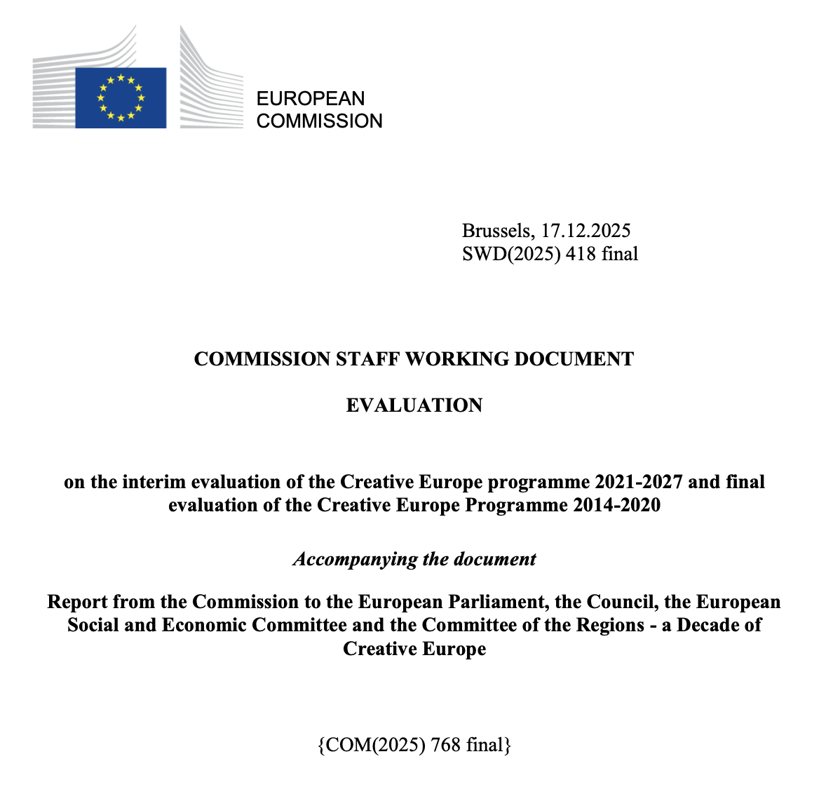
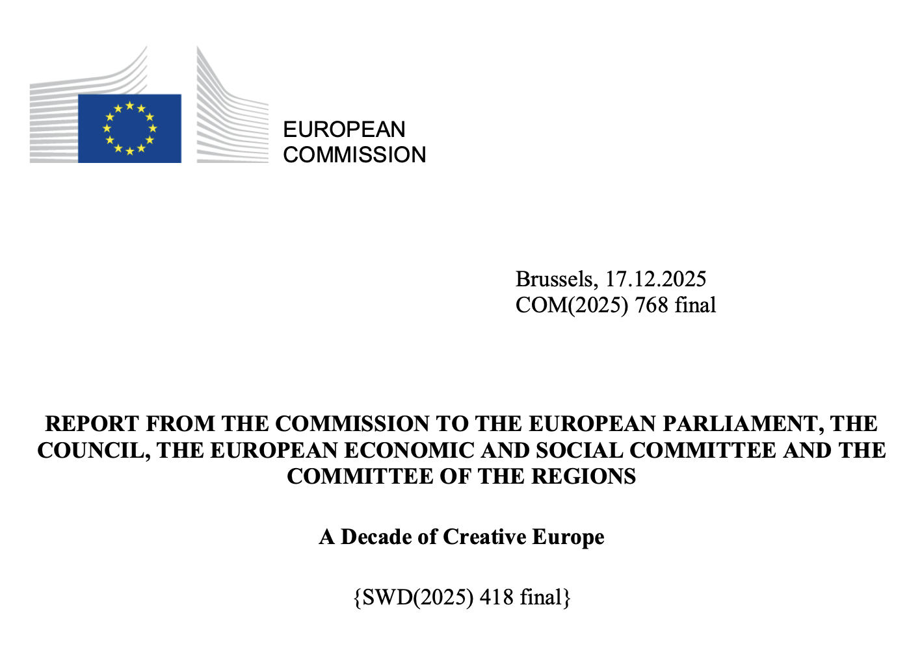
Creative Europe Reporting (1/6)

Slide 12
Creative Europe Reporting (2/6)
‘A Decade of Creative Europe’ and Evaluation Report (December 2025)
  Creative Europe (2014-2020): final report
  Creative Europe (2021-2027): interim report
Preliminary takeaways during CULT Committee hearing (September 2025)
  Success of Creative Europe.
  Oversubscribed and under-funded
Why are the reports useful?
  Official data (internal, stakeholders, beneficiaries)
  Findings support APT campaign priorities re: AgoraEU

Slide 13
Creative Europe Reporting (3/6)
‘A Decade of Creative Europe’ (Creative Strand focused)
  “some sectors are not sufficiently represented […] such as fashion and design.” p4
  “efforts are still needed to reach out to countries that are not sufficiently engaged" p4
  “demand for funding [is] up to four times greater than the current available budget for the Cooperation projects action, shows the high demand from the CCS for the strand.” p6
  ”There is a persistent gap between demand and available funding. Adjustments have been made [...] capping the number of projects the same organisation can be a part of…” p4
  “sectorial approach addressed specific challenges of certain sectors, while the horizontal approach offered agility and leeway […] It is important to keep a combination of both” p6

Slide 14
Creative Europe Reporting (4/6)
Evaluation Report (Culture Strand focused)
  “The evaluation of the Programme shows that the strand is effective, efficient, relevant with strong EU added value, while entailing low administrative costs.” p88
  “Budget limitations affect the effectiveness in meeting the objectives set.” p79
  ”many interviewed stakeholders recommended that future budgets account for inflation and consider revising the allocation across different Programme strands” p196
  “ [COOP] represents the cornerstone of the strand, covering 60% of its budget. Currently, many high-quality proposals do not get funding due to oversubscription” p89
  “low success rates under the Culture Sub-programme/strand, which can disproportionately impact smaller organisations and first-time applicants.” p191

Slide 15
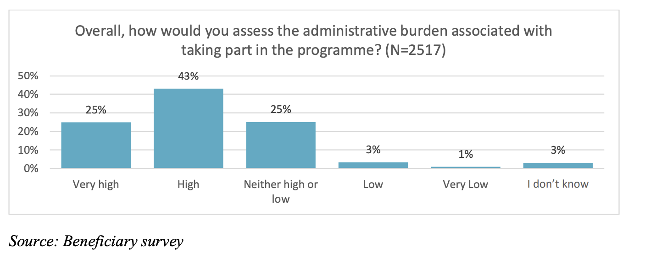
Creative Europe Reporting (5/6)
68% of beneficiaries consider CE’s administrative burden “high” or “very high.” p197

Slide 16
Creative Europe Reporting (6/6)
Evaluation Report (Culture Strand focused)
  (CE 2014-2020) “a total of 8,688 full-time equivalents (FTEs) were reported to have been created… nearly 11,000 employees were reported to have been trained or upskilled” p179
  “Creative Europe Desks were the main source of information on the Programme reported by respondents to the beneficiary survey (53%) […] followed by EACEA at 35%.” p191
  “there is friction between the European Commission and the Executive Agency regarding the integration of special calls into work programmes. An EU-level policymaker highlighted that the EACEA operates within a rigid structure with established procedures” p202
  “Creative Europe funding has been essential for addressing gaps in national funding opportunities across several Member States and sectors.” P204
  “If their organisation had not received funding […] Only 6% felt their organisation would have implemented the projects/funded the activities without co-funding from Creative Europe.” p211

Slide 17
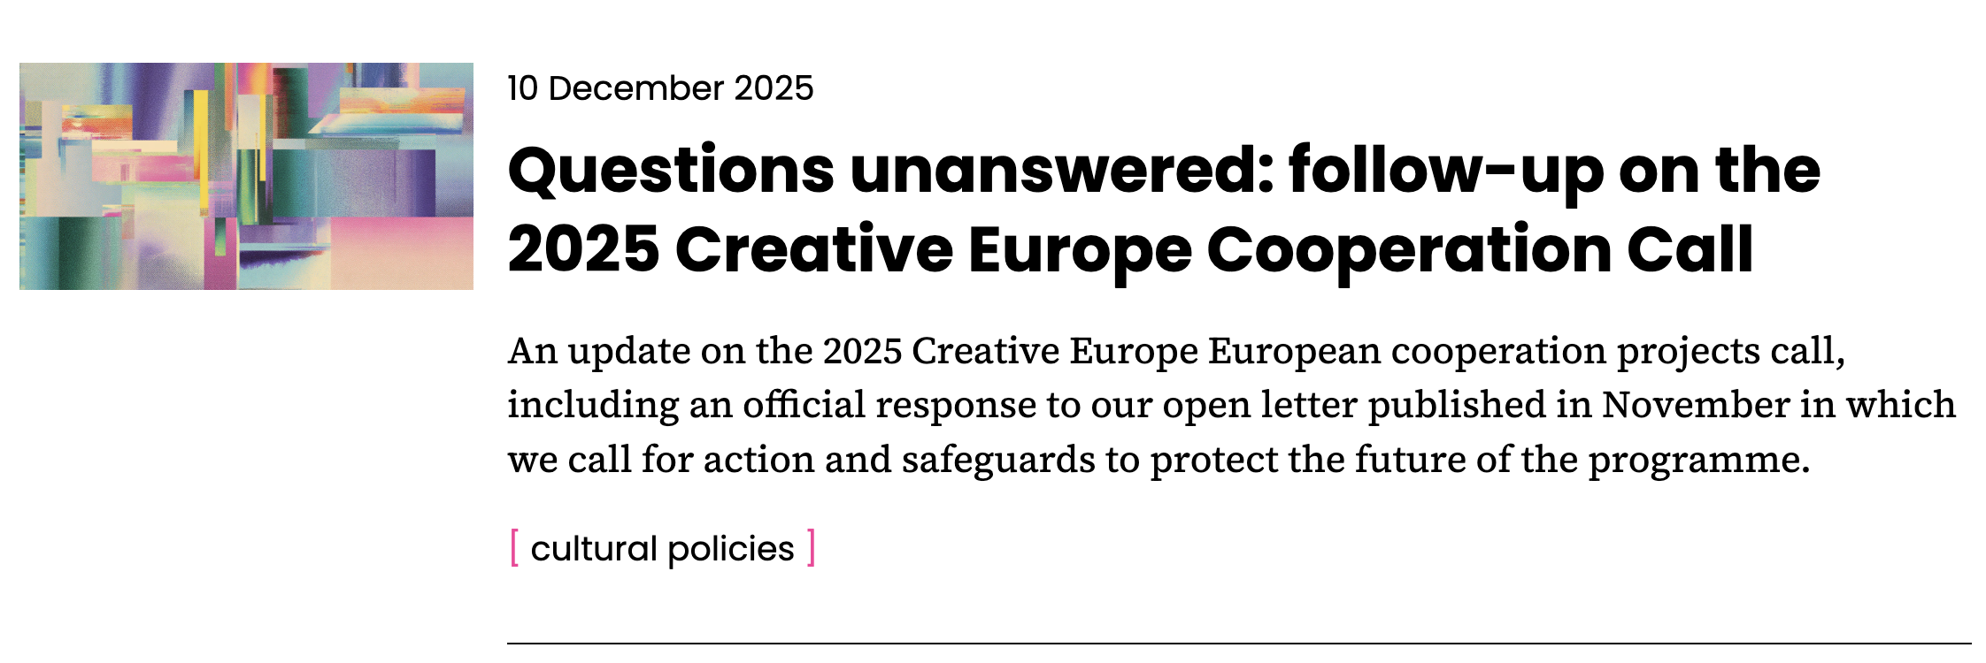
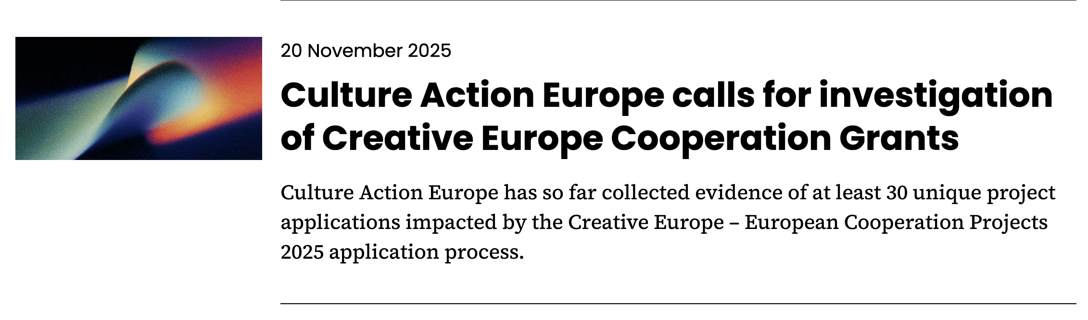
COOP Call – Update (1/4)

Slide 18
COOP Call – Update (2/4)
Letter received from EACEA Director (23/12/2025)
  “EACEA is examining the potential shortcomings of the current notification system on the associated partners and will duly assess every formal complaint received.”
  “discussions on […] the corporate grant management IT system are already ongoing.”
  “the complaints related to the alleged ‘inclusions without consent’ in proposals are being taken very seriously”
  “in certain instances, investigations on alleged unauthorised use of PICs […] have been triggered by the submission of redress requests.”
  ” responsibility of ensuring […] compliance […] rests with the coordinators […] we firmly believe that the selection has been implemented fully in line with the provisions.”
  ”Once the situation analysed as a whole, EACEA will be able to adopt appropriate decisions on a case-by-case basis.”

Slide 19
COOP Call – Update (3/4)
Project Coordinators (December 2025)
  Contacted by EACEA to confirm ”explicit consent” of organisations
  ”together with supporting documents […] or otherwise explain what happened.”
Redress follow-ups (January 2026)
  Organisations contacted to confirm ”potential unauthorised use of PIC”
  7 days to respond to confirm any proposal(s) for which consent was not provided
  “Should you not reply […] we will understand that your PIC has been used with your knowledge and consent in all the proposals you were involved in for that Call.”
  Warning that action ”may result in administrative sanctions, including exclusion from all future EU procurement contracts, grants, prizes, and expert contracts, as well as potential financial penalties of the coordinators of the proposals who used the PIC without authorisation.”

Slide 20
COOP Call – Update (4/4)
Our position
  Not in line with the collaborative spirit of Creative Europe
  The focus should lie on resolving issues
  The technical implementation of the call is the core issue
  Coordinators are faced with a dilemma, with potentially severe consequences
  Risk of turning the sector against itself
What now?
  Prepare for the results of redress cases (Q1 2026)
  Ready to engage constructively with the Commission on procedural solutions

Slide 21

Thank you!
Luiza Moroz, Head of Policy
Rhys Nugent, Advocacy Officer
luiza@cultureactioneurope.org
rhys@cultureactioneurope.org
cultureactioneurope.org

