Slide 1
Culturopolis
Alicja Kaczmarek
Director
Centrala Space
Barcelona,
18.11.2022
Twitter, Instagram:
@centrala-space
Facebook:
@centrala_space
ART GALLERY CREATIVE SPACE

Slide 2
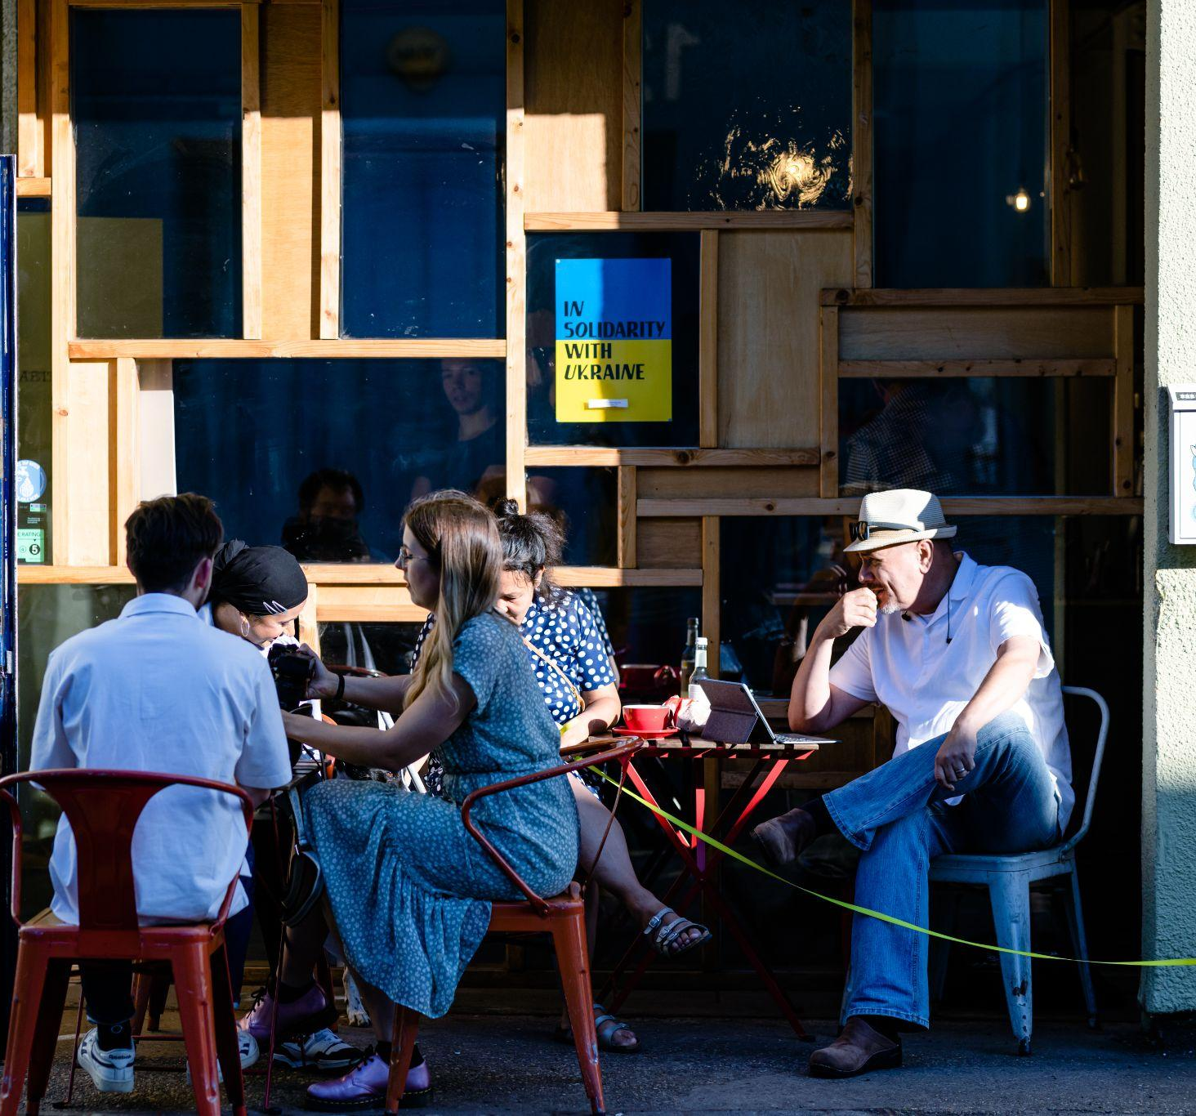
Who We Are
Creative space in Birmingham consisting of:
Art Gallery
Community Space
Music Venue
Event Space
Cafe and Book Shop
Notes:
Image: gallery from outside looking in full of people - crush

Slide 3
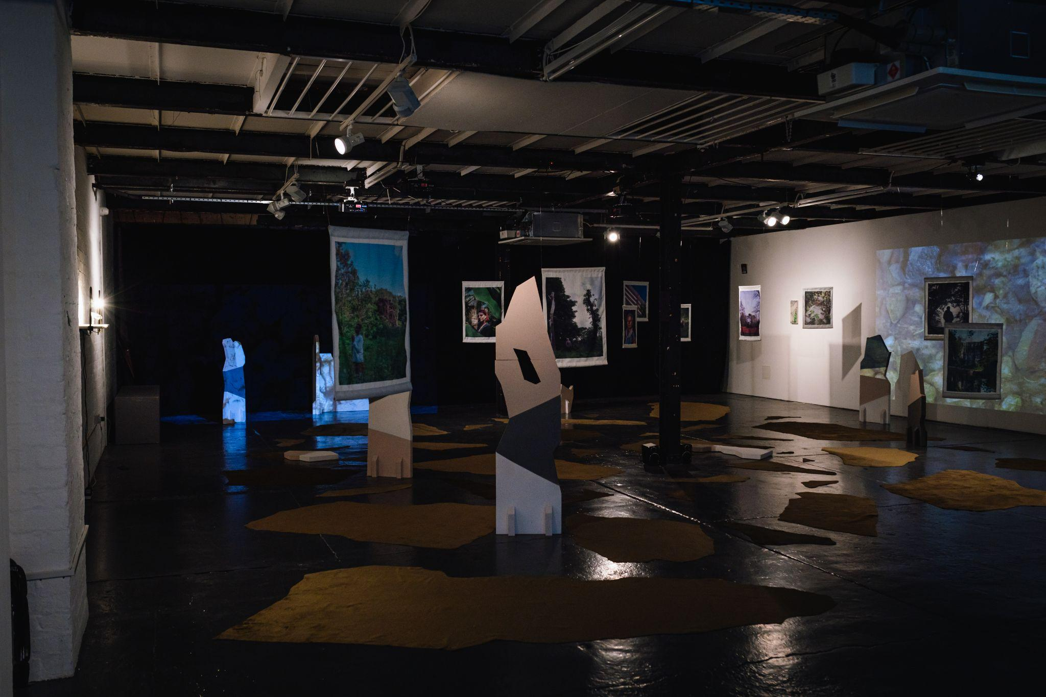
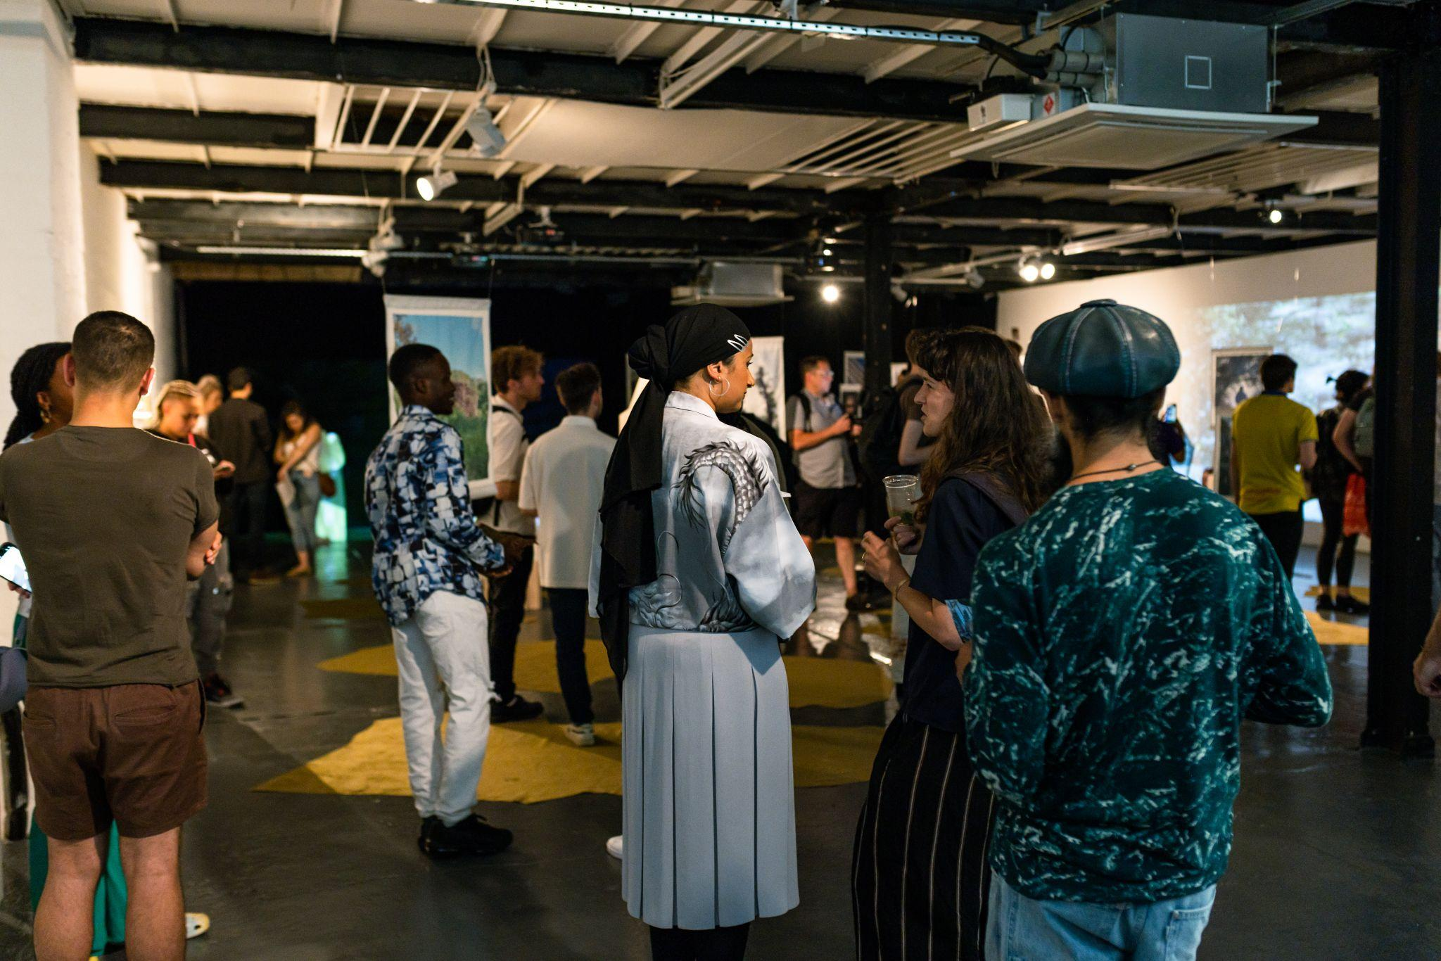
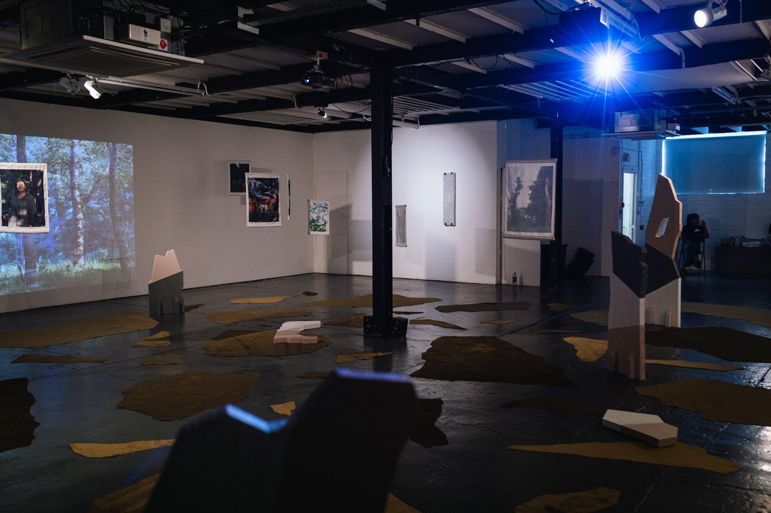
Our Story
Centrala started in 2009 as a Voluntary Organisation and developed moved into a creative space in 2014
It came as a response to the need of creating a space and offering support to the newly arrived European Migrant Communities.
It is an established Centre for Central and Eastern European art and artists both n ationally and Internationally.
Notes:
First image: Maybe have photo of centrala during process of construction or photo of directors anything to signify beginning. Or when the gallery looked different - basically an older photo but a strong one
Second Image

Slide 4
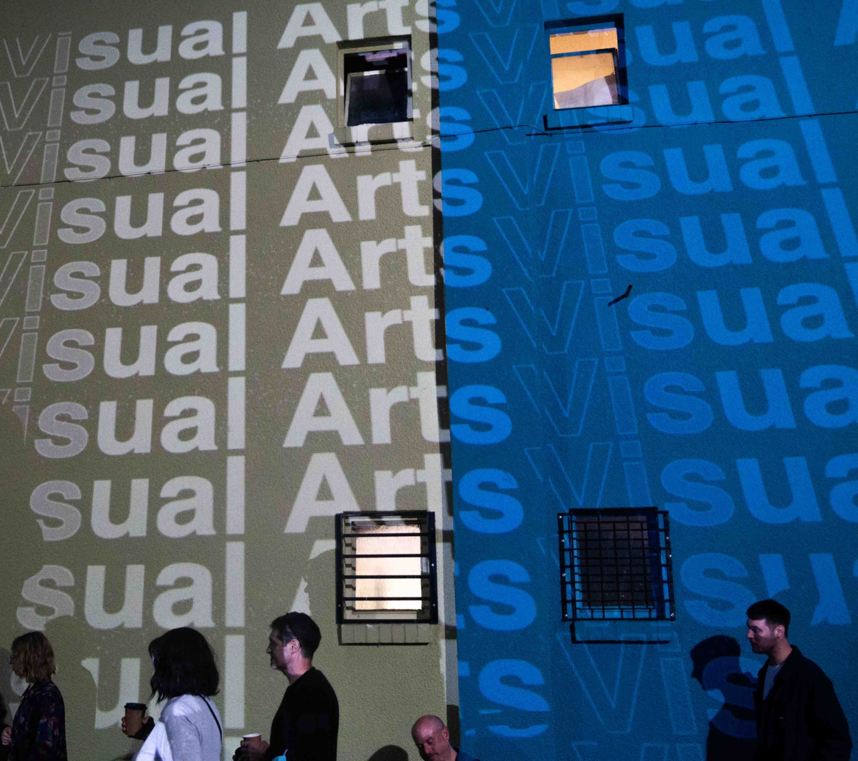
Our Mission
We are powerful advocates for social integration, bringing together diverse audiences under one roof to share, explore, debate and connect with high quality art and events.
We strive towards a society where Central and Eastern European communities are welcomed and integrated, and where their art, culture and heritage is recognised and understood.
Our aim is to create an inspirational meeting place and a platform for building social ties.
We support new migrants in their adaptation and integration in the UK, and to raise cultural awareness and understanding.
Notes:
Strong image - similar level to downing st photo like something that shows national/international levels

Slide 5
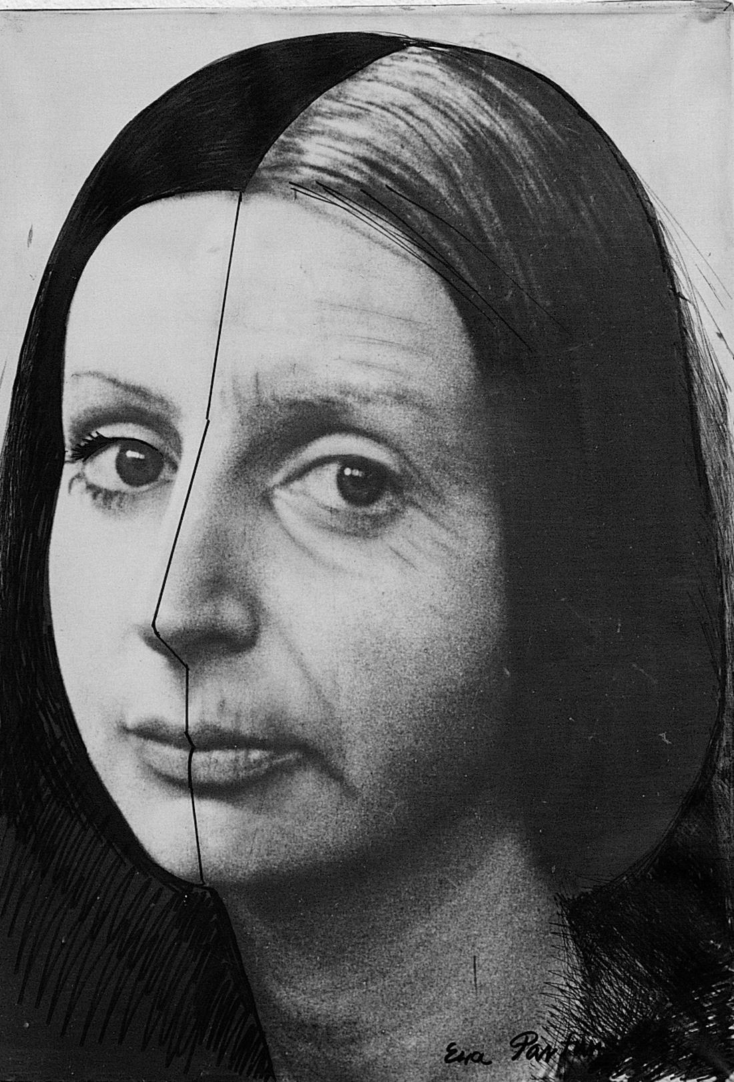
Art Programme
Innovative, socially engaged programme, encourages appreciation of CEE arts in the UK.
Exhibitions, film screenings, discussions, workshops and artist residencies.
Our main programme focus on bringing artists from CEE to the UK to fill the gap in programming
Collaborative approach with artists, researchers and community organizers.
International and national collaborations.
Supporting CEE emerging artists
Showcasing work from established world known artists.
Ewa Partum
‘My problem is a problem of a Woman’ 06.05–25.06.2022
Notes:
Need to be split into two slides ideally -

Slide 6
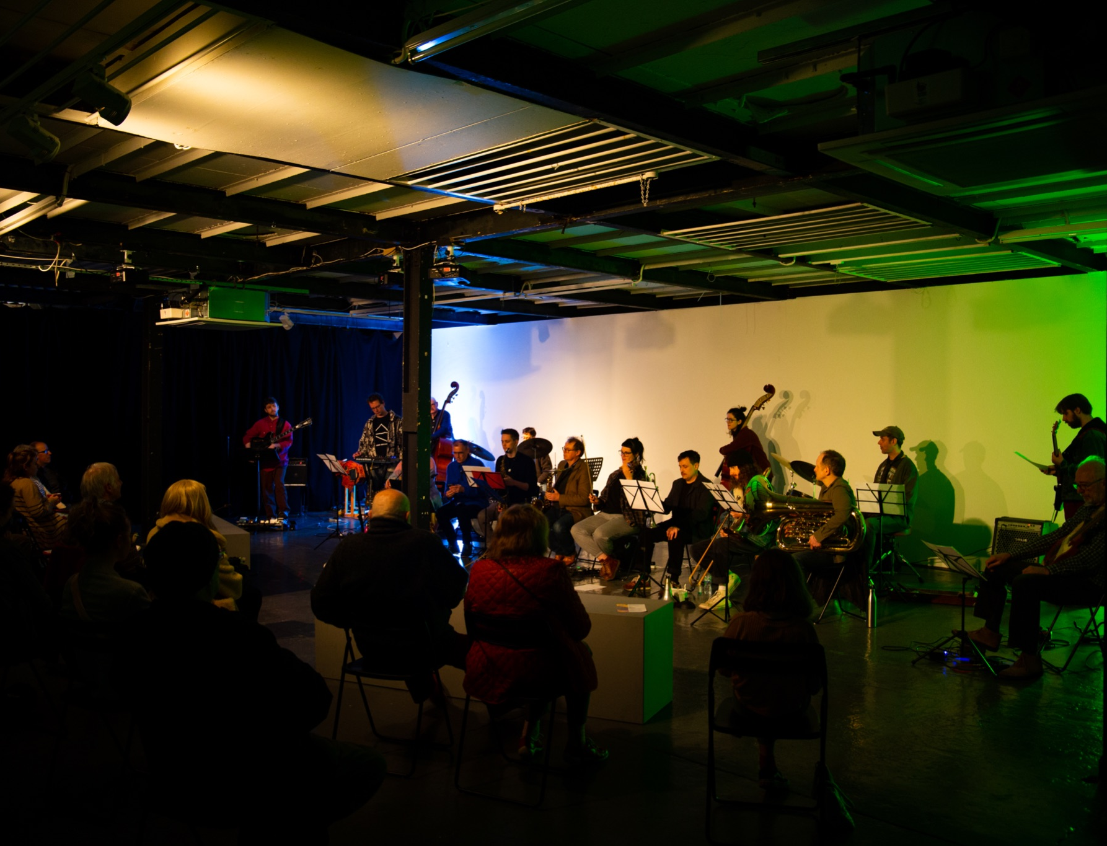
Music Venue
Specialised in electronic and experimental music as well as other contemporary genres
We are a platform for CEE performers
Hosting local as well as international performers, we’re championing music from around the world.
Collaborating with conservatoires, universities and local festivals, as well as hosting regular composers and signwriting networks.
Incubators and Lab for new ideas and space for experimentation

Slide 7
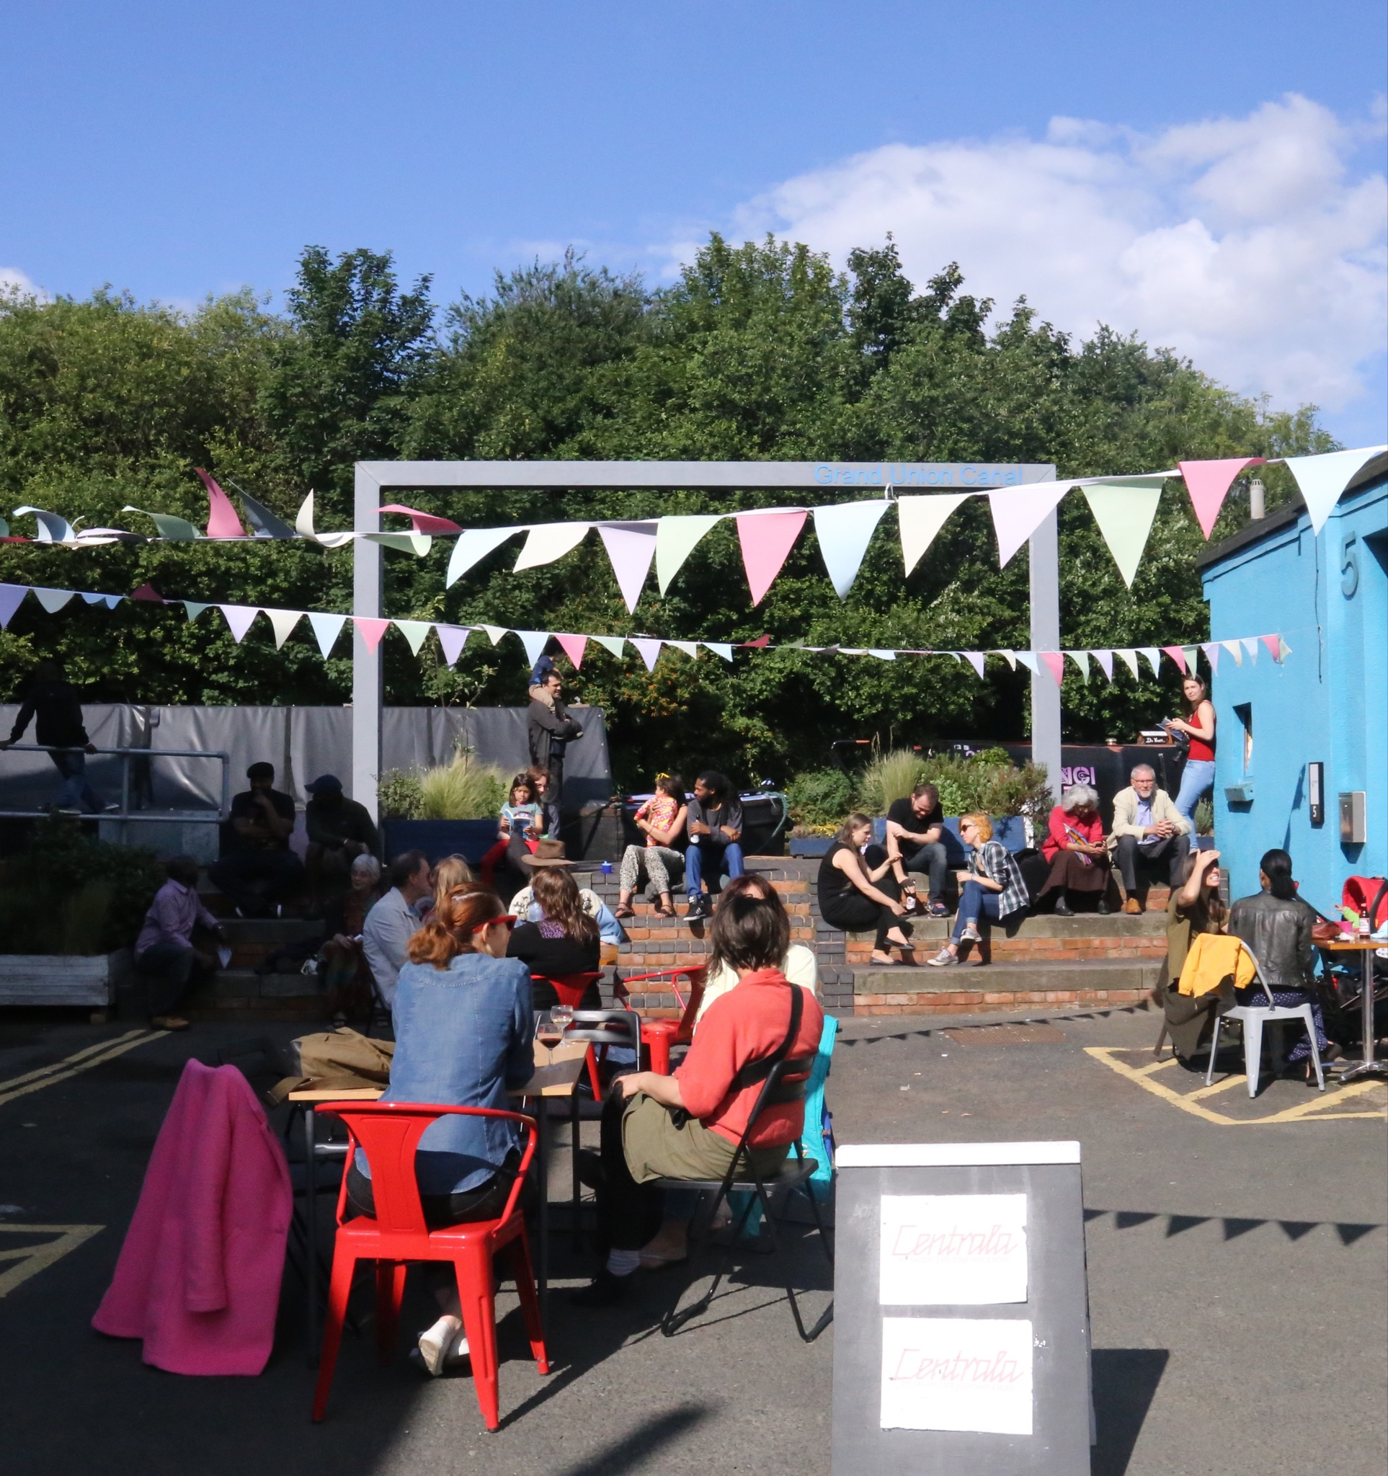
Migrant integration and advocacy
CEE us programme; a network of collective innovators creating a Migrant presence.
Migrant Forum; providing an opportunity to meet others and discuss issues relevant to our communities and build solidarity.
CEE Leaders Forum; regular meetings of leaders providing response and representation of our communities.
Representation, advocacy and policy influencing work
Creative Freelancers Networks.
Regular cultural events; exhibitions, music, family events, talks and workshops.
Notes:
Need to be split into two slides ideally -

Slide 8
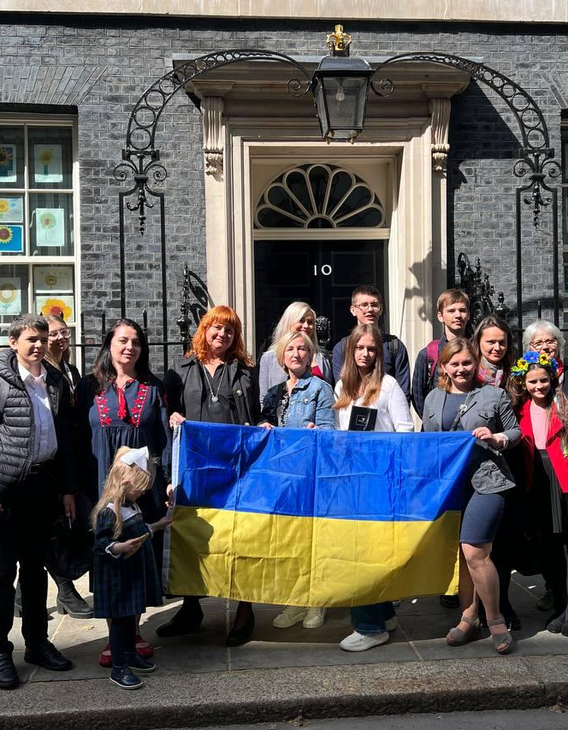
Advocacy and representation
Flexibility and responsiveness of current social and political issues related to CEE migrant Communities including crisis interventions
Contributing to development of new migrant and integration policies
Challenging of excising policies which do not include migrants as minority and protection group in the Equalities Act 2010
Challenging current approach to diversity trough categorisation and ethnic dived
Challenging underrepresentation of CEE art in the UK
Notes:
Very strong image

Slide 9
Research
Migrant Essential Workers. The project investigates how the pandemic affects their everyday lives and settlement plans in the UK. 2020-21 with Universities of Glasgow, Sheffield, Middlesex
Young adults in Poland. British Council's Next Generation Research. Research project about Polish young adults’ attitudes, their engagement and worldviews as well as opinions on politics and social life, commissioned by British Council. 2020 in partnership with Stocznia and Youth Connections
Post-Socialist Britain?: Memory, Representation and Political Identity amongst German and Polish Immigrants in the UK. A project exploring what happens to the connection between collective memory and political identity in the process of migration. Ongoing
In-between Spaces: Inclusion and Representation of Central and Eastern European (CEE) Artists in the UK Creative Economy. This rapport is meant to spark a discussion about CEE artists representation in the UK, and to call for fresh look of how the diversity is 'measured' and to review current diversity boxes. University of Birmingham 2019
Testimony in Practice: Working with Stories of the Self and Others. The main focus of the project was rediscovering and celebrating memories of CEE migrants remembering the system change of 1989. University of Birmingham 2019
Notes:
Very strong image

Slide 10

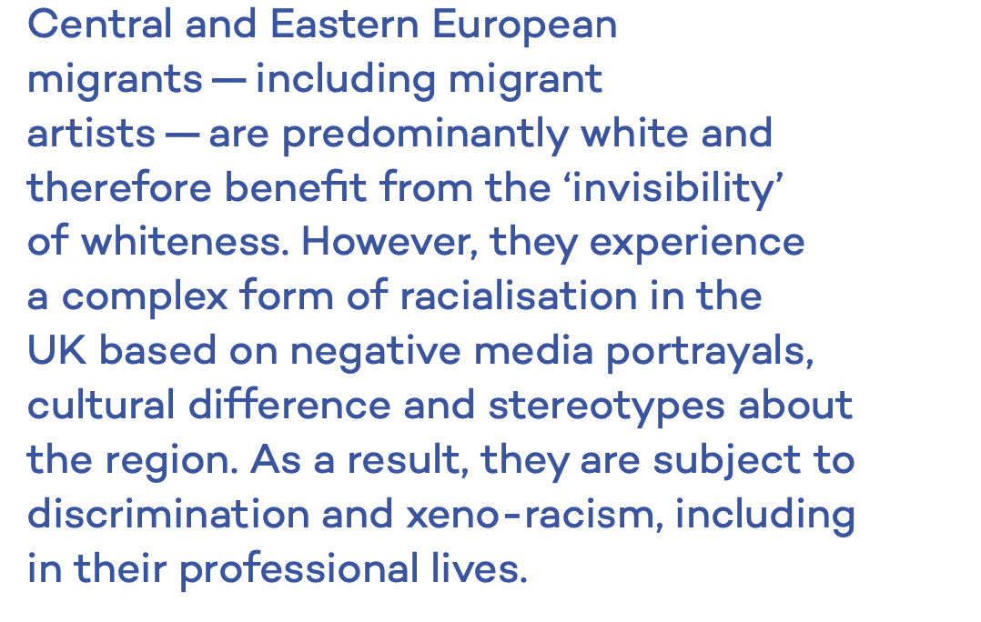
Notes:
Very strong image

Slide 11
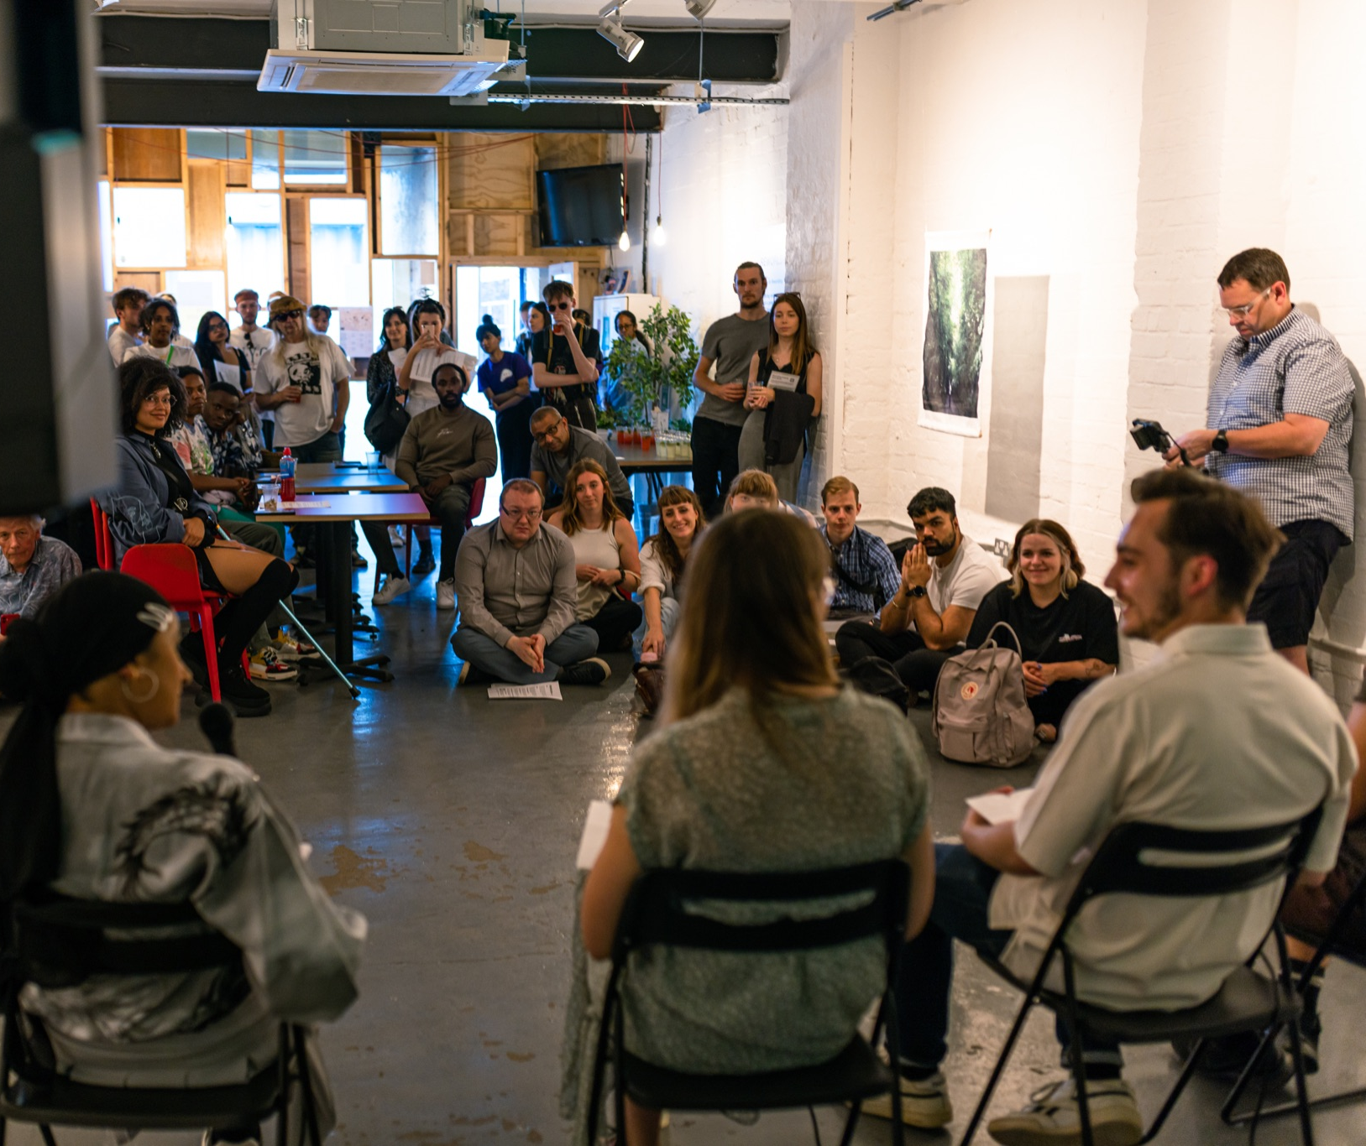

Slide 12
ART GALLERY CREATIVE SPACE
Contact:
Alicja Kaczmarek
Director
alicja@centrala-space.org.uk
+44 7506284879
Unit 4 Minerva Works
158 Fazeley Street Birmingham B5 5RT 0121 513 0240
centrala-space.org.uk

