Slide 1
Culturopolis, 17 November 2022
Ivo Oosterbeek, Catarina Gomes
Mapa das Ideias

Slide 2
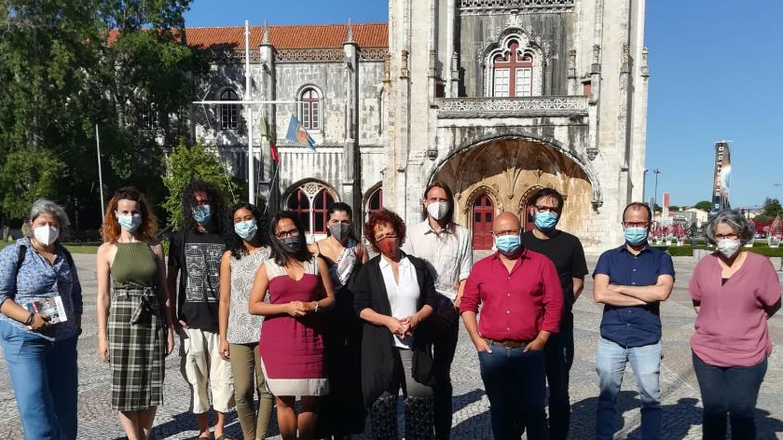

Building local networks

Slide 3
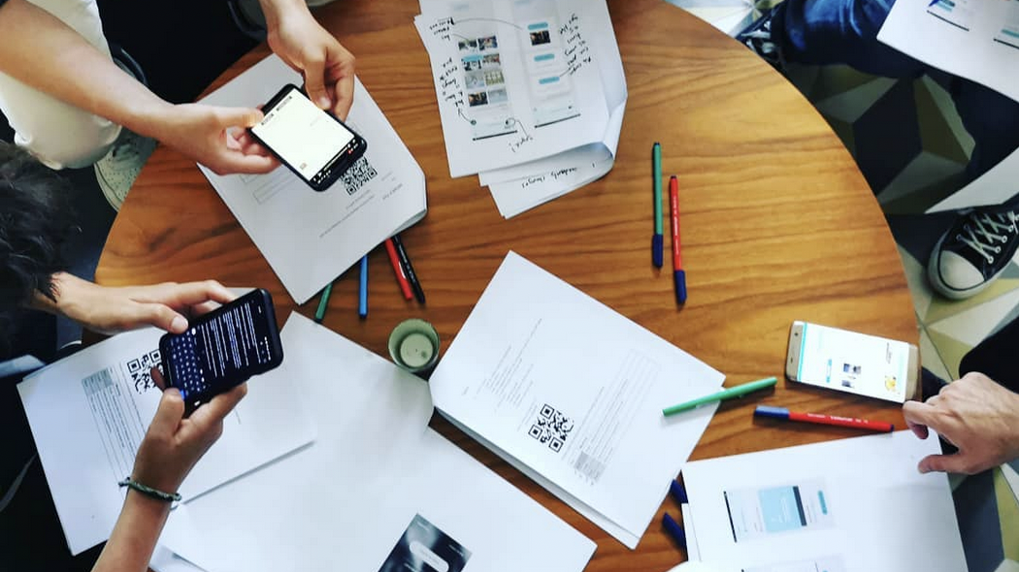
App development and co-design

Slide 4
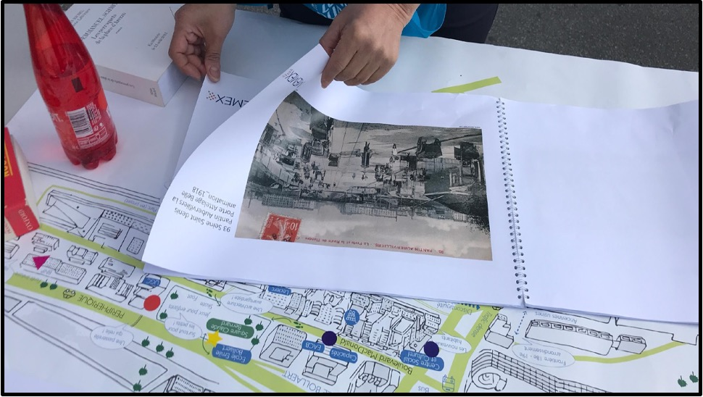
Pilot mobilization

Slide 5
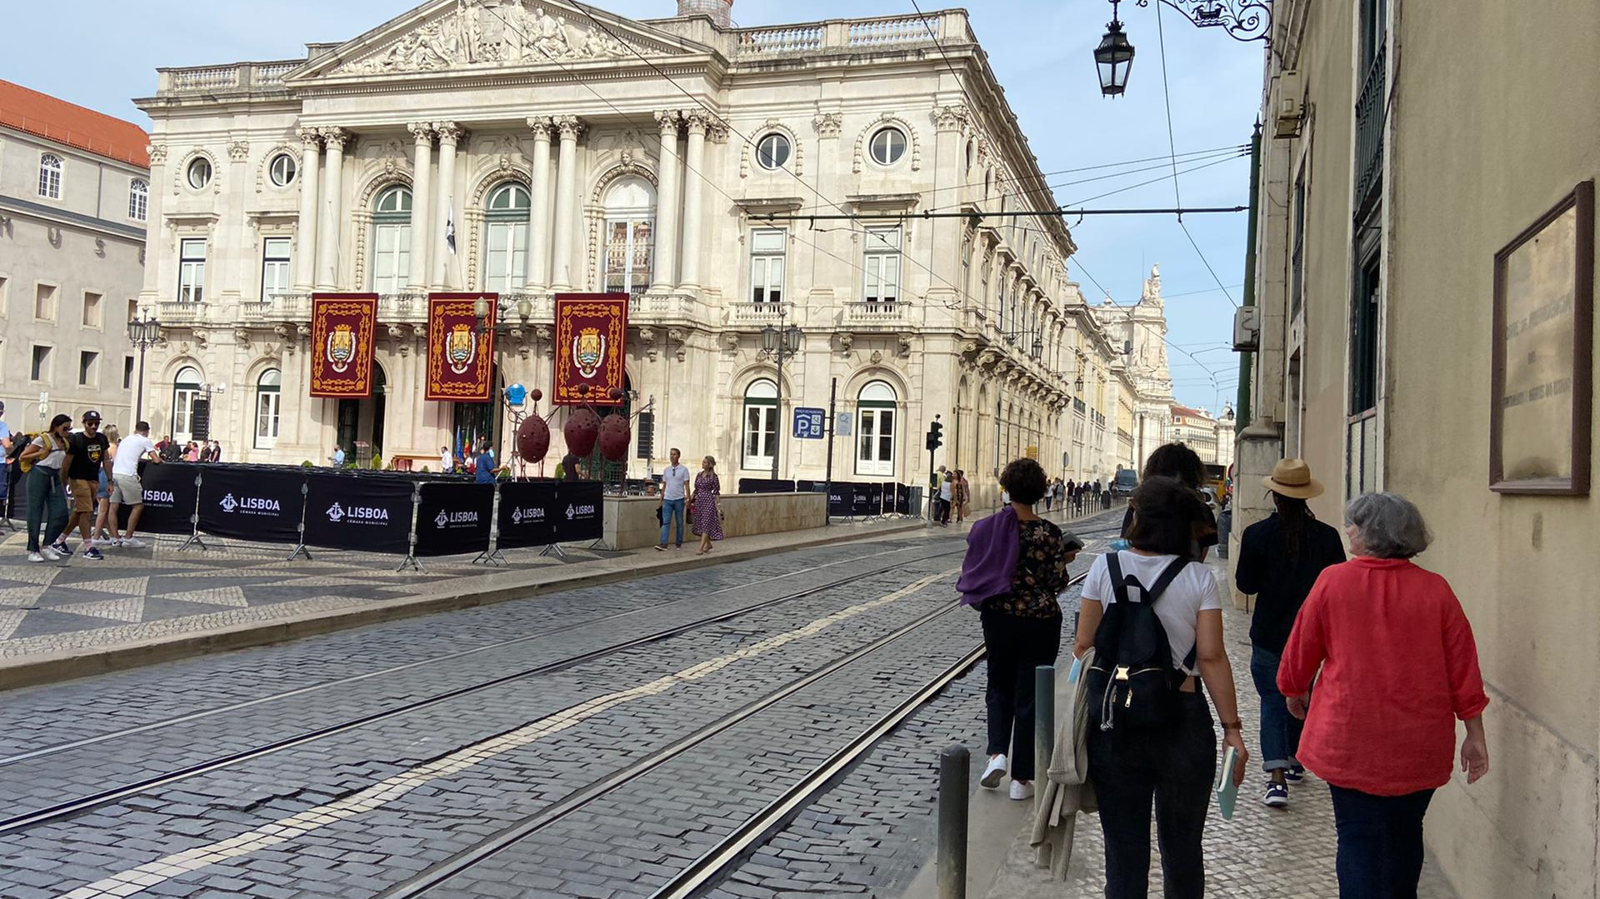
Storytelling workshops

Slide 6
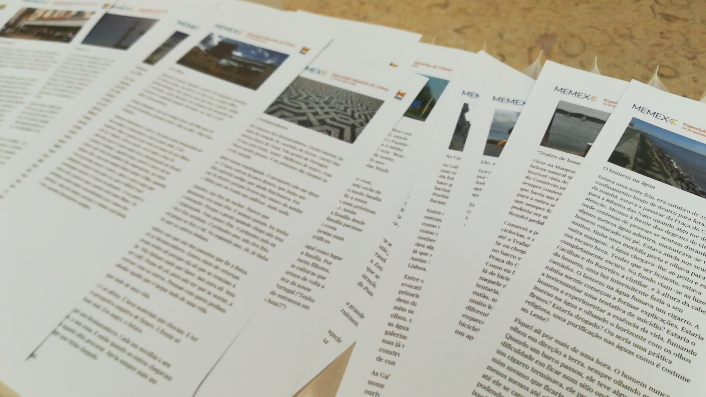
Workshop results

Slide 7
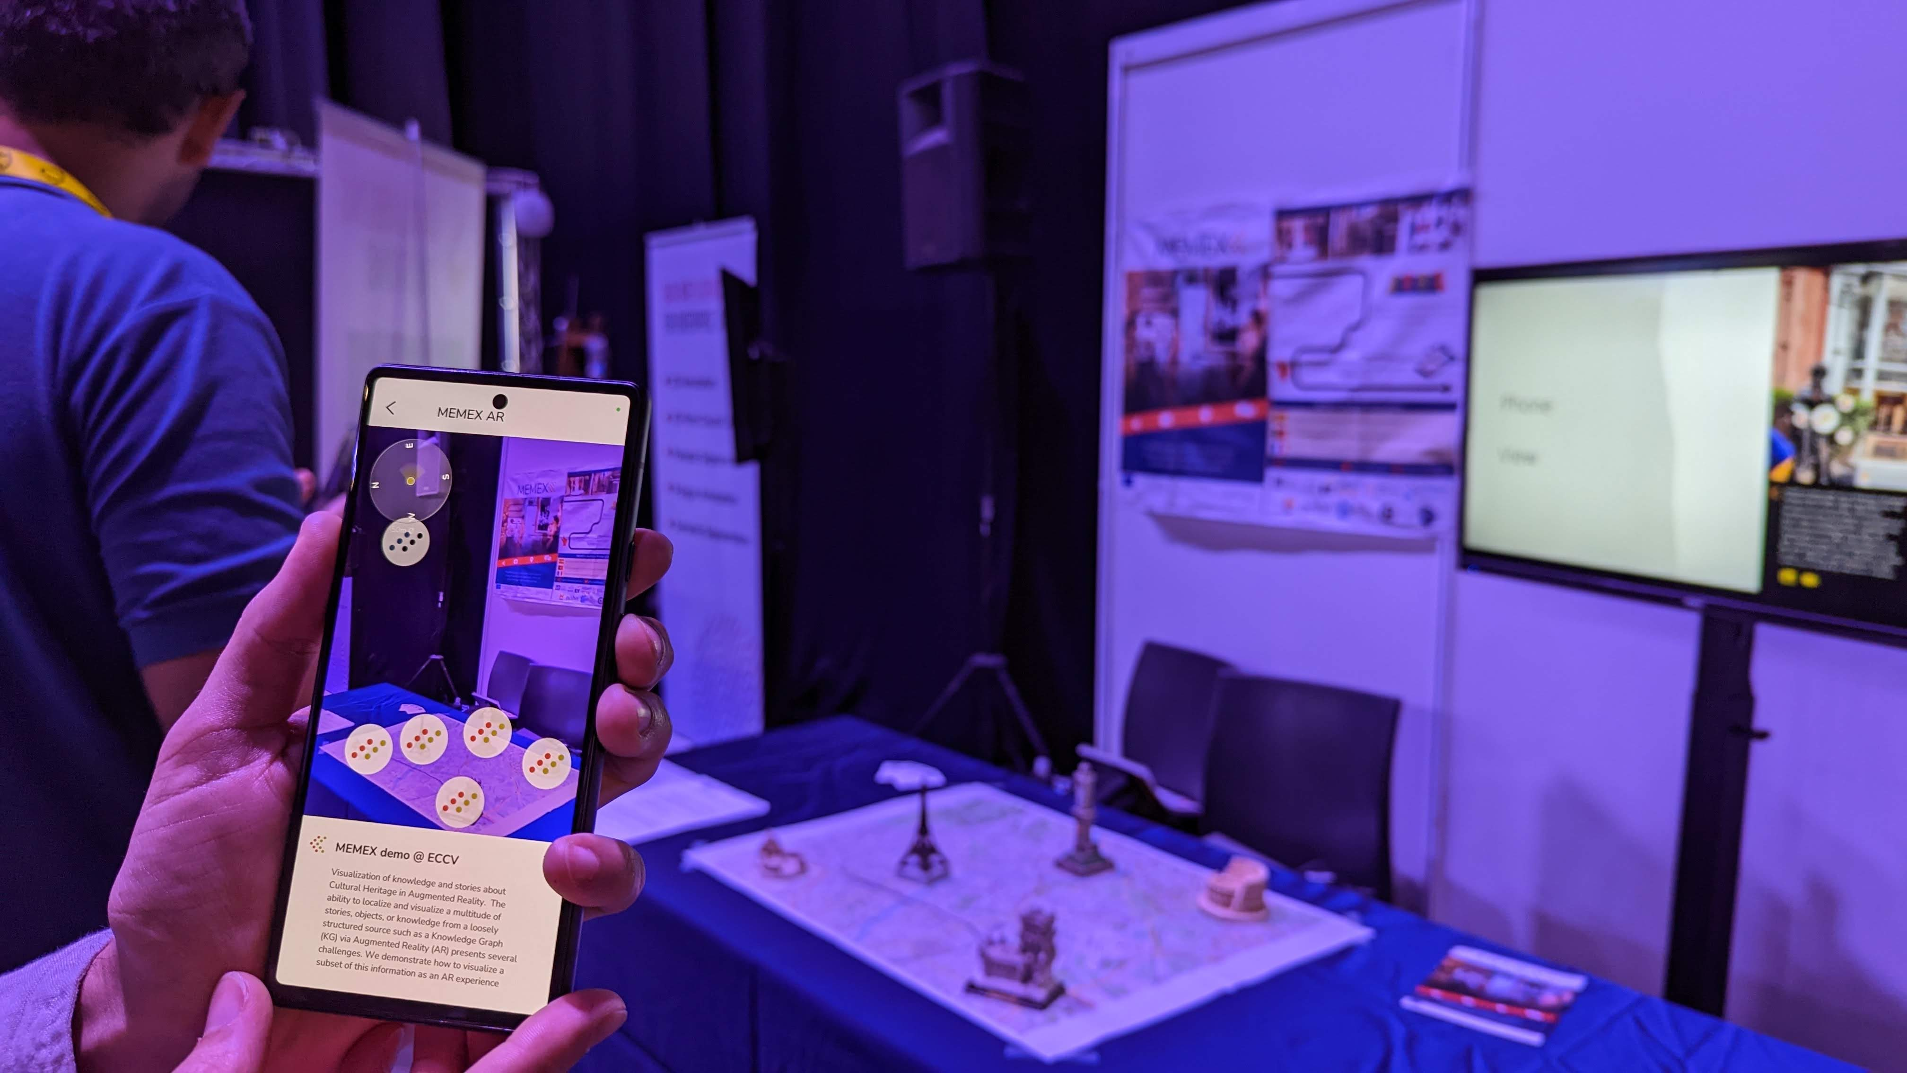
Using the MEMEX App

Slide 8
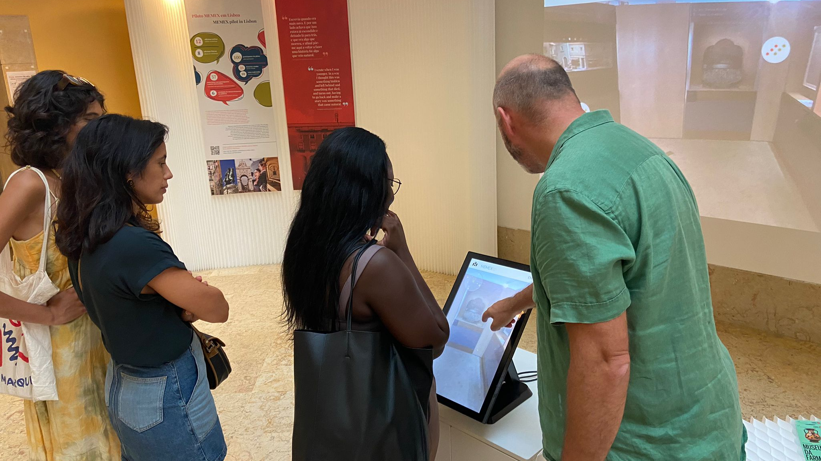
Community outreach and exhibition

Slide 9
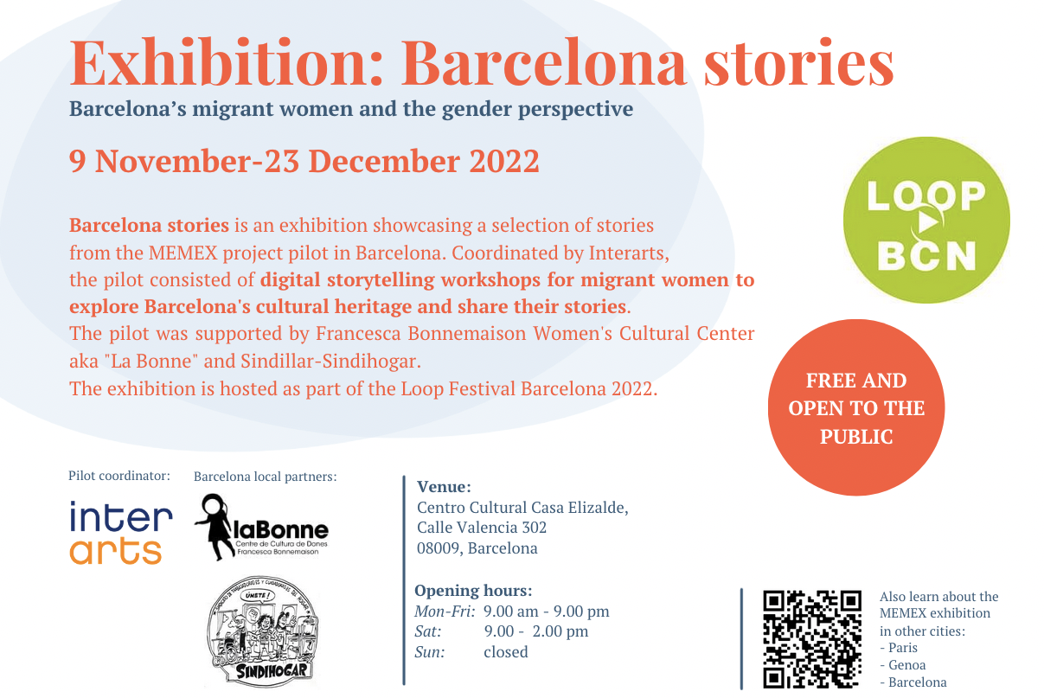
Community outreach and exhibition

Slide 10
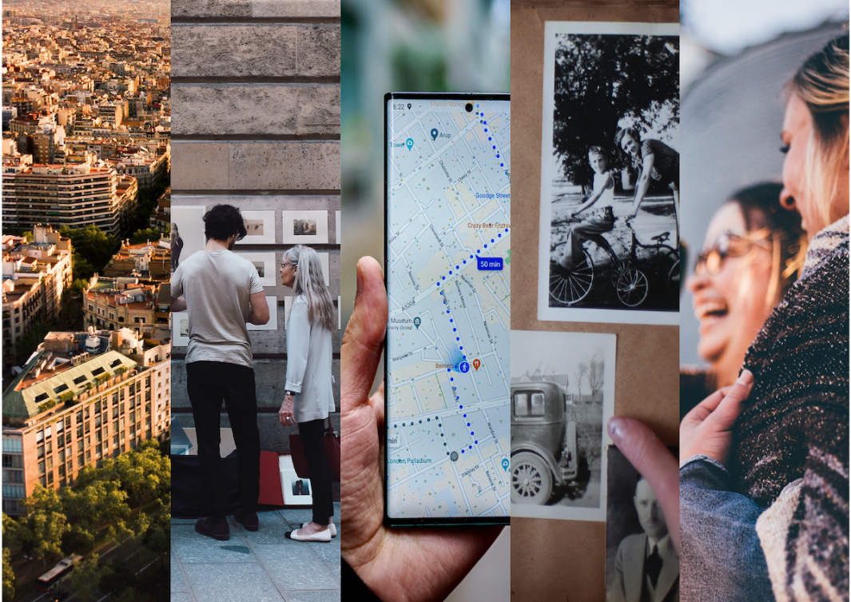



Contacts
Thank you for your attention!
Follow us
https://memexproject.eu/
@memexproject
Contact us
ivo.oosterbeek@mapadasideias.pt
catarina.gomes@mapadasideias.pt
alessio.delbue@iit.it

