Slide 1
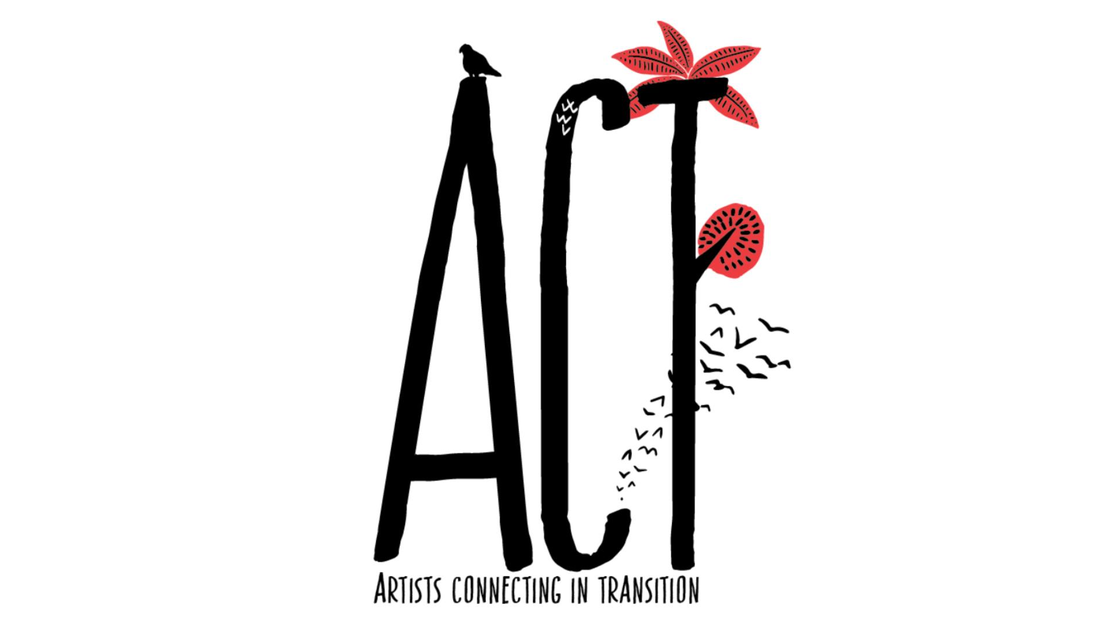
Notes:
Background to project

Slide 2

Clymene Christoforou
D6: Culture in Transit
D6: EU
Notes:
The connection with today’s conference Culturopolis is that all the partners are fervent defenders of cultural rights and human rights in general as the common basis on which to define our common actions, goals and even co-existence.
Not just for the sake of it but to recentre our production on developing our capacities to maintain democracy. There is no place in this design for discrimination of any kind (social, economic, cultural), no place either for domination and injustice.

Slide 3

THE PARTNERS
Fervent defenders of cultural rights and human rights as the starting point to define our common actions, and goals.
Notes:
The connection with today’s conference Culturopolis is that all the partners are fervent defenders of cultural rights and human rights in general as the common basis on which to define our common actions, goals and even co-existence.
Not just for the sake of it but to recentre our production on developing our capacities to maintain democracy. There is no place in this design for discrimination of any kind (social, economic, cultural), no place either for domination and injustice.

Slide 4
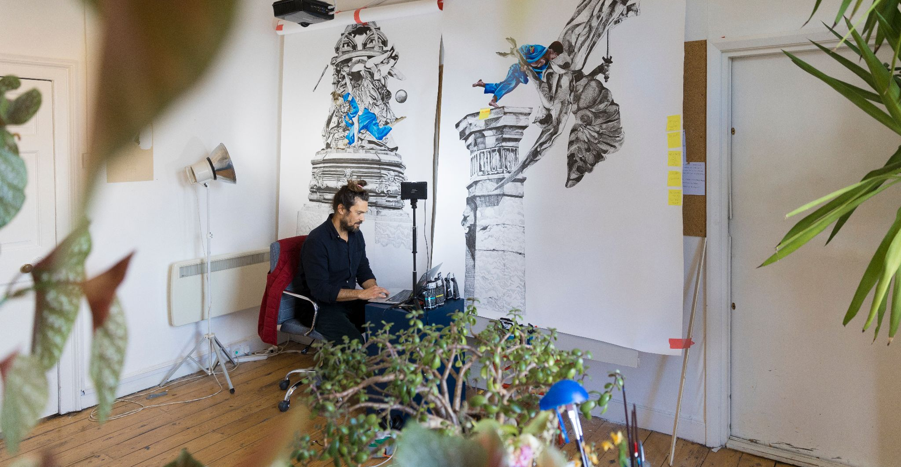

D6: Culture in Transit
Notes:
At D6 Culture in Transit we are visual arts producers. Research in the form of new ideas, understanding and exchange, lies at the heart of what we do. Overarching our current programmes of work is the aim to reclaim the positive, powerful, and concealed narratives around migration, diversity and cultural heritage. We support artists whose practice as research represents an exploration of heritage at the intersection of environmental sustainability, gender, social justice, race and decolonisation.
Here we see artist Marcio Carvello from Portugal in residence this summer.

Slide 5
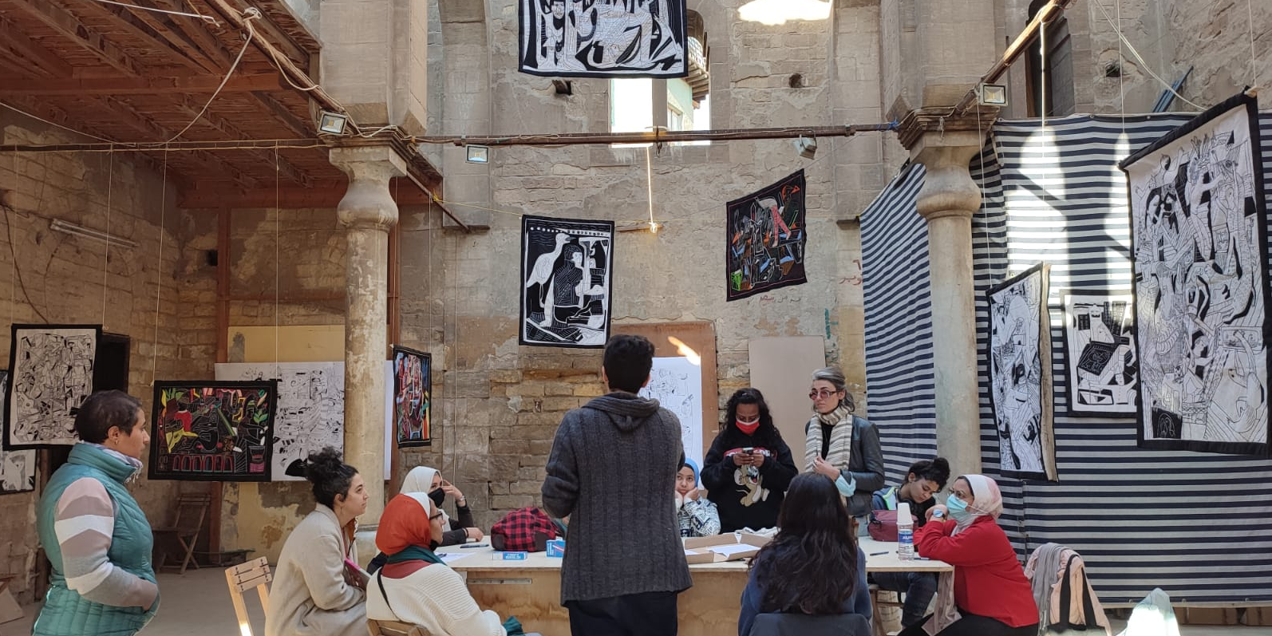
Fanak Fund
Notes:
Fanak Fund facilitates the mobility and creativity of artists and cultural operators living and working in the Arab-speaking world, Europe and the wider Middle East, to enhance cultural and artistic development at the local level, defend cultural rights and to favour multilateral connections and networking.
Here we see an exhibition by Maninelkaos, an Italian artist in conversation in Cairo about Egyptian tradition of khayameya in contempory art

Slide 6
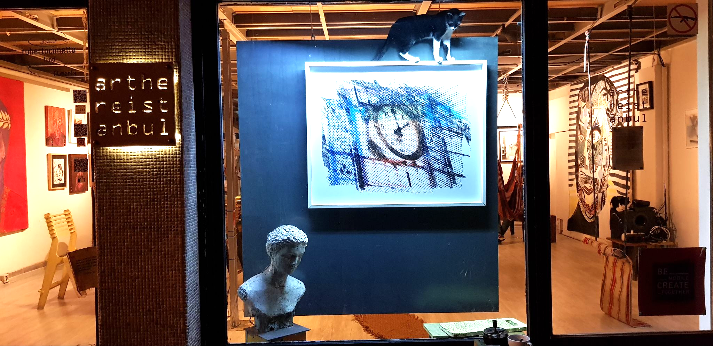
Partners Slide 2 ArtHereIstanbul
arthereistanbul
Notes:
As an artistic hub, located in Istanbul, a stone’s throw from the Asian side’s coastline, arthereistanbul has been welcoming international art residents since the program was first launched in 2017.
As an active member of the community, in a thriving, multicultural district, arthereistanbul is a regular host to a variety of exhibitions, workshops, music performances, book readings, and other cultural events.
Here we see images of work by Omar Berakdar

Slide 7
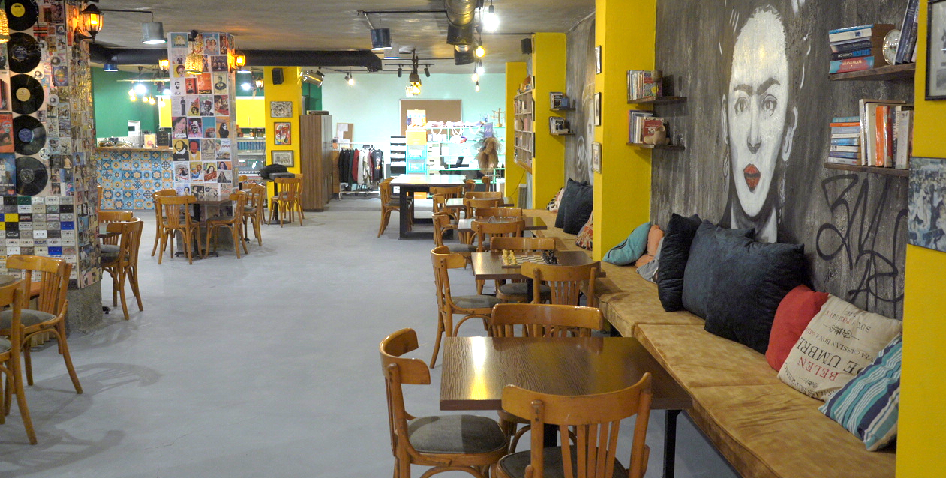
Partners Slide 2 ArtHereIstanbul
MedeArts
Notes:
MedeArts Network was established as an initiative from the heart of Irbid city from northern Jordan in early 2015, through a group of active young men and women in the cultural, artistic and architectural fields with the aim of creating a decentralized cultural system that includes applying culture and arts to advocate for societal and human rights issues and to promote freedom of expression.
Here we see an image the garage art space…..

Slide 8

THE RESEARCH QUESTIONS

Slide 9
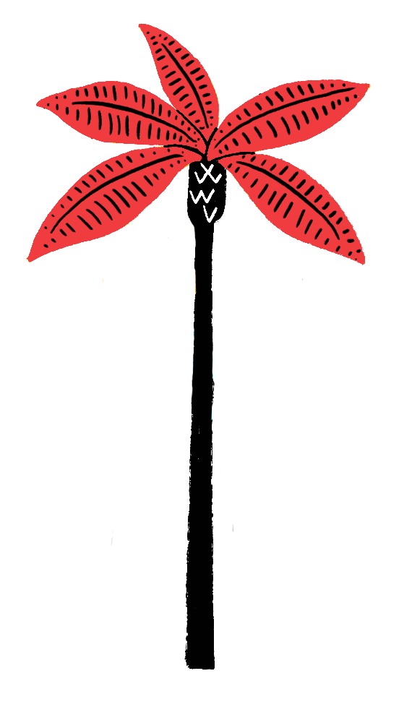
Artists Connecting in Transition (ACT) works with artists who are displaced, whose practice has been disrupted and for whom international mobility is not always an option.
It asks:
How do we best support the practice of individual artists in exile?
How can artists in exile engage in international networking?
What kind of capacity building is needed to share knowledge between organisations and artists?
Notes:
whose practice has been disrupted and for whom international mobility is not an option

Slide 10

How do we best support the practice of individual artists in exile?

Slide 11
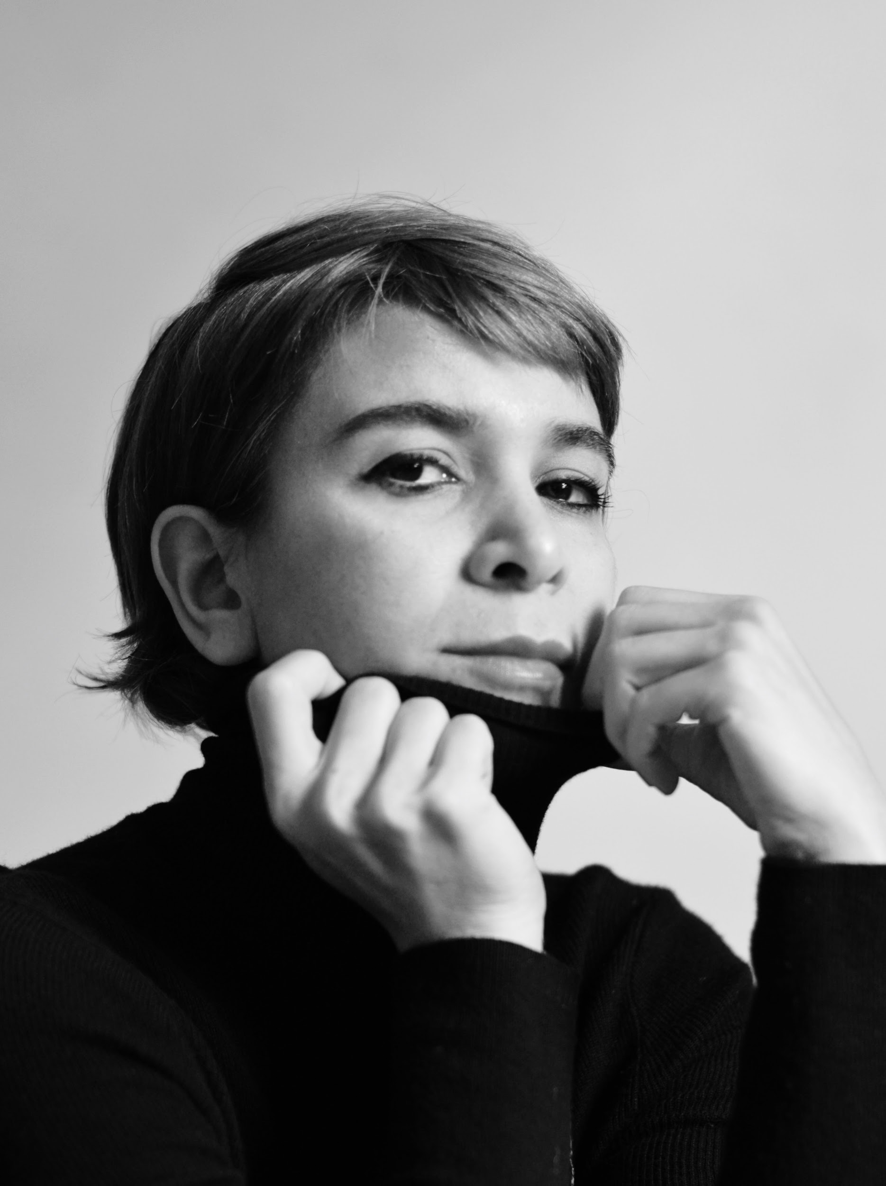
Dr. AMAK MAHMOODIAN
My work questions notions of identity and home, bridging the space between the personal and the political. As an exiled women from Iran for the last 12 years I’m exploring the effects of exile and distance on memory, dreams and daily life.
Medium: Photography/Poetry
Born in Shiraz, Iran
Based in Bristol, UK
Notes:
Born in Shiraz, Iran. Lives in Bristol, UK.
My work questions notions of identity and home, bridging a space between personal and political. Through my journey I explore the effects of exile and distance on memory, dreams and daily life.
In 2015, I completed a practice-based doctorate in photography at the University of South Wales, having previously studied at the Art University of Tehran. Working with images, poems and archives she looks for the lyrical realities frames in the photographs. I have shown my work extensively and won numerous awards.
As an exiled women from Iran for the last 12 years I wish to explore - via photography & poetry- if the dreams i have which are my form of connection to my lost home & family - are replicated in others in similar situations.

Slide 12
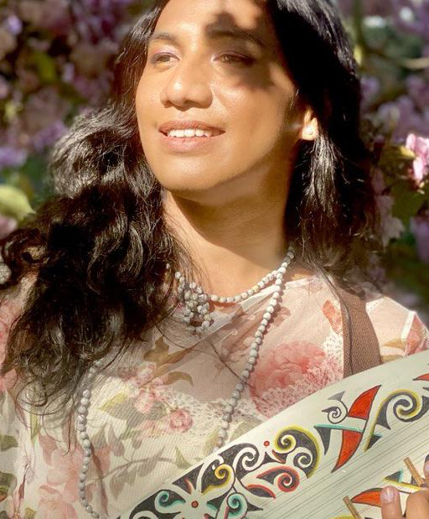
ZARIQ ROSITA-HANIF
“My art revolves around Malaysian cultural heritage and sometimes advocacy for transgender issues. I am seeking asylum due to the criminalisation of the transgender community in my country.”
Medium: Illustratration/ Sculpture/ Poetry
Born in Malaysia
Based in the UK
Notes:
She is an autodidact artist originally from Malaysia currently seeking asylum in the UK due to criminalisation of transgender community in her original country. She practices paper cut illustrations and mixed media visual art. Her art revolves around Malaysian cultural heritage and sometimes advocacy around transgender issues. She is also a freelance illustrator for independent authors and NGOs. As a full time artist-illustrator, she earns by producing merchandises that feature her artwork like totebags, tshirts, prints, stickers and notebooks under the brand she shares with a Filipino artist-activist, AR Arcon, named Kertaspapel. Based in Gloucester, she’s currently expanding her portfolio by learning and practising other art forms such as picking up Sampe’ (Borneo Traditional Lute) and writing children’s book and bilingual poetry (Malay-English).

Slide 13
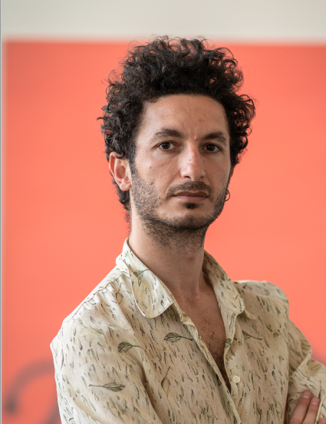
HAZEM WAKED
“My artistic practice is related to my life, to my displacements. War, prison and exile are three completely different worlds. How can I build my relationship with these very different places?
Painting is my own reality, where what I have experienced becomes concrete. It is a poetic device of my testimonies. “
Medium: Painting
Born in Syria
Based in Paris, France
Notes:
Born in Syria in 1988, Hazem WAKED is a multidisciplinary artist focused on painting. He graduated from the faculty of fine arts, majoring in visual communications, in Damascus 2013. After being arrested for his political and artistic activities in 2014. He moved to France as a political refugee in 2016, where he obtained a master’s degree in Art / Painting studio, from LA HEAR / Arts high school of the Rhine in 2021, Strasbourg. WAKED’s artistic practice is mainly related to his life journey, from war and prison in Syria to new life in Europe. His conceptual researches are deployed around the poetic image, the displacement, and daily life story.
My artistic practice is mainly related to my life, to my displacements between several space-time: War, prison and exile are three completely different worlds. How build my relationship with these very different places? The painting is my own reality, where what I have experienced becomes concrete. It is a poetic device of my testimonies. My painting unfolds around the relationship between absence and presence, memory, daily life and the poetic image. I try to combine the pictorial gesture with the poetic gesture. Gesture-sound, colors-time, image-story, cinema-poetry are the recurrent objects of my reflections. An artist like Walter Swennen, a poet like Riyadh Al-Saleh Al-Hussein, a director like Kiarostami are artists who accompany me in the issues I am addressing today. His recent work produces an incomplete, made of gaps and lacks, of which the viewer would be invited to find the invisible part. WAKED has participated in several exhibitions in Damascus, France and Germany. Currently, he lives and works in Paris.

Slide 14
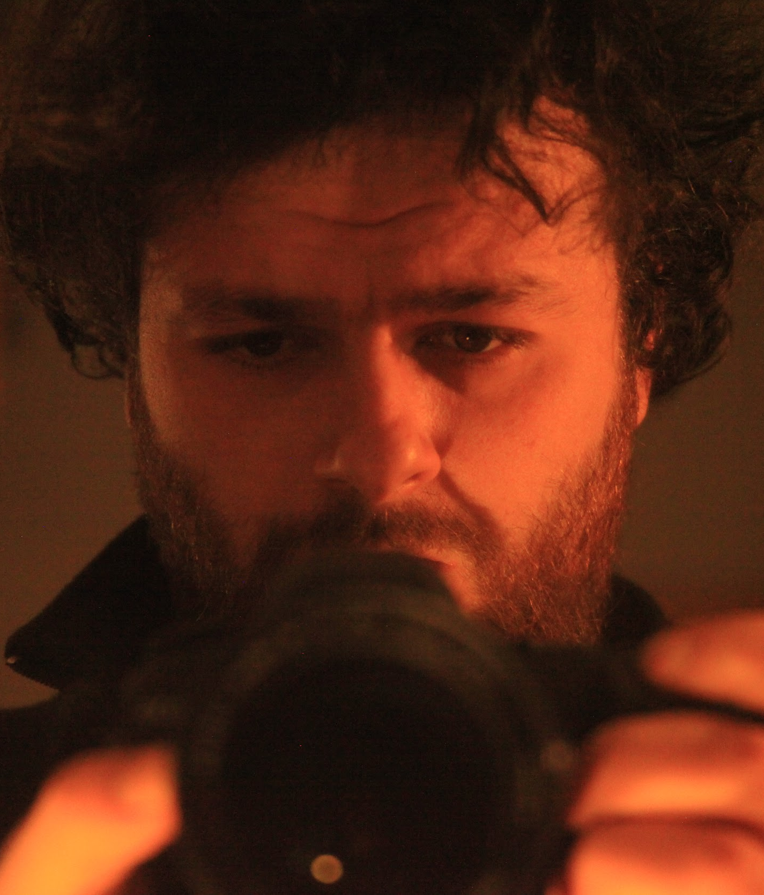
AMMAR AL HAMIDI
“I am a filmmaker. "Nowhere Man" is a poetic documentary - a story (my story-our story) of an refugee artist living illegally in Istanbul. Struggling with a nowhere feeling which triggers his traumas, he holds up his existence through his art, which is the only thing keeping him sane.”
Medium: Film
Born in Syria
Based in Istanbul, Turkey
Notes:
multimedia Artist born in Syria,live in Istanbul,Turkey ,musician , film maker and designer.
have made four films and one music album as one crew man/one man jam band.

Slide 15
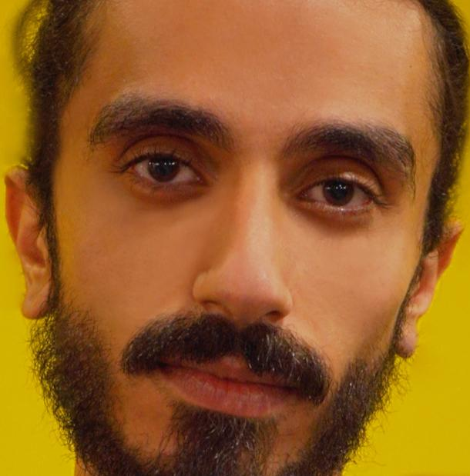
MOHAMMAD S. BITAR
“I grew up in the arms of a musical family in Syria and have worked as a photographer, graphic designer and film and music producer. Today I revive traditional songs as a rite of hope.”
Medium: Multi disciplinary
Born in Syria
Based in Irbid, Jordan
Notes:
Passionate Syrian artist with 6 years experience in audiovisual content creating, worked as a photographer, Graphic designer and
filmmaker, music producer, have experience in cultural and arts work with several local and international organizations and
institutions, enterpuneer, a licensed trainer in human development, Received award for best soundtrack in “Al Khartoum Short Films Festival”. Culture, the arts, social work, and the audiovisual content industry were the main factors in refining His personality and beliefs, as she charted a clearer path for him in his life’s journey towards enabling him to help himself .and others to develop and change during difficult life circumstances Muhammad Bitar, nicknamed "Mido", is a young man who grew up in Syria and grew up in the arms of a musical family. Which made him today a stringed instrument coach and a choir coach in the city (Irbid - Jordan), to which he moved from the womb of .for war Suffering to suffering and in his heart the weight of a rite of hope, for example Today, however, he considers the music arranger, cultural director, and inclusive artist an example of pain and a face of optimism, with his smile. that breathes the soul into the heart of this life Won the Best Original Score Award at the Khartoum Film Festival for a movie under the name A Bird without a Homeland” by the Algerian director, Louisa Kadri.
He participated in reformulating the traditional song with Jordanian musician Tariq Al-Nasser within the Galton Music Project and Tariq Al-Jundi within the “Return” project Home”, he contributed to founding the musical group (Balad), which worked on reviving the traditional song. And many more One of the cultural and artistic activities that extended since 2014 until today in Jordan and the world through His passion for music was based on the development of educational methods in music culture and social work to produce a project for us The birth of the need to learn and change. Under the name “Betat”, a musical project aimed at social change and dissemination Musical awareness in society

Slide 16
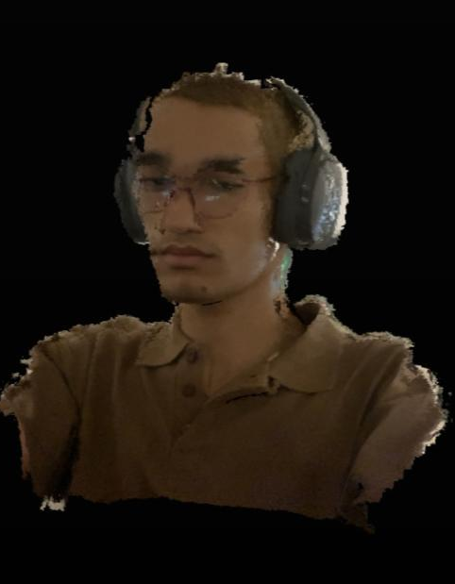
HESCHAM KARSHAN
“I am a multidisciplinary artist exploring the intersection between technology and human experiences, surfing around the physical and digital realms.”
Medium: Digital Art
Born in Jordan
Based n Irbid, Jordan
Notes:
Hescham Al Karshan is a multidisciplinary Jordanian artist who mainly works with digital mediums (3D modeling and animation, virtual and augmented realities) exploring the intersection between technology and human experiences, surfing around the physical and digital realms.
In the meta era where technology is drifting us apart, dehumanizing and disconnecting us
from the real world, it sparks my interest to explore the intersection between technology and
emotions, and how we can use that to strengthen our connection with homeland while in
Diaspora.
Hescham Karschan is a Jordanian rising artist surfing between the real and digital realms who primarily works with digital mediums such as 3D modelling, animation, digital painting, virtual and augmented reality experiences. Essentially, my roots inspire my practices to debate and illustrate the intersection of technology and intimacy, self-expression, advocacy for social injustice and human rights, geopolitical and postcolonial issues as well as exotic tales in kitsch culture.
Hescham did research with remote closeness to document fortune-telling practices in Jordanthrough on-foot field research. The results of the scout were documented in a video showcasing 3D-modeled forms replicated from the abstract illustrations that came from the various readings the artist went through during the research journey.
سبب اهتمامك بهذه الفرصة motivation your s'What
As Jordanian whose family was displaced from Palestine, I have always found it hard to
belong somewhere, growing up listening to my grandma's tales about her adventures in
Palestine filled my heart with the feeling of belong to somewhere so near yet so far,
somewhere I have never seen except on social media and the internet, fast forward to
adulthood I found my asylum on the digital realm, where one can create whatever they dream
MedeArts Network <secretary@medearts.com>
New Form Entry
MedeArts <moatoum@gmail.com> Tue, Jul 19, 2022 at 11:45 PM
To: secretary@medearts.com
8/3/22, 12:43 PM MedeArts Mail - New Form Entry
https://mail.google.com/mail/u/0/?ik=7ddfc654f2&view=pt&search=all&permmsgid=msg-f%3A1738815339478343343&simpl=msg-f%3A17388153394... 2/2
of. In the meta era where technology is drifting us apart, dehumanizing and disconnecting us
from the real world, it sparks my interest to explore the intersection between technology and
emotions, and

Slide 17

How can artists in exile engage in international networking?

Slide 18

Networking =
Equity, Generosity, Openness, Listening and Care
One to one mentoring with producers in different countries
Peer networking between artists in country and beyond borders
International visibility through digitisation of their work
Local exhibitions in each location
Online and in person capacity building sessions

Slide 19

What kind of capacity building is needed to share knowledge between organisations and artists?

Slide 20
Ferdinand Richard
Fanak Fund
Notes:
The connection with today’s conference Culturopolis is that all the partners are fervent defenders of cultural rights and human rights in general as the common basis on which to define our common actions, goals and even co-existence.
Not just for the sake of it but to recentre our production on developing our capacities to maintain democracy. There is no place in this design for discrimination of any kind (social, economic, cultural), no place either for domination and injustice.

Slide 21
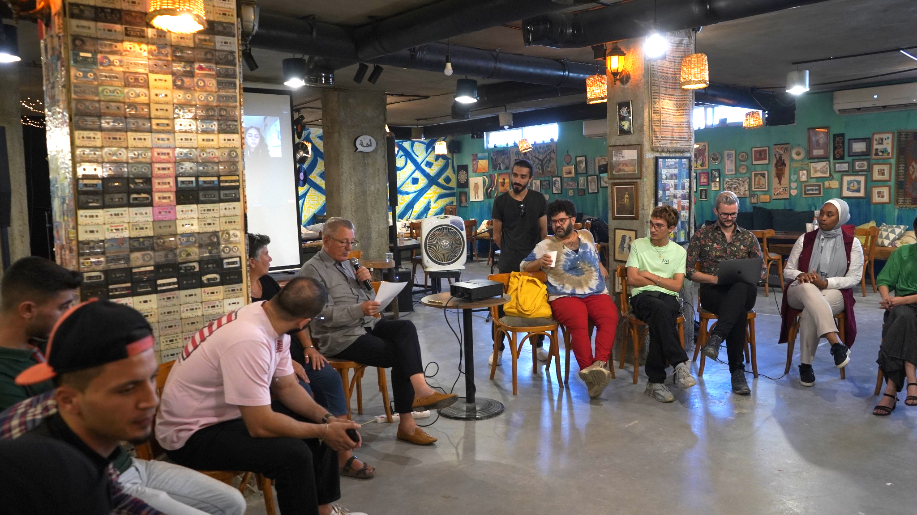

Capacity Building workshop in Jordan (October 2022)

Slide 22
Capacity Building workshop,
MedeArts, Irbid, Jordan
5th October 2022
Questions addressed:
What support do artists in exile need to develop their professional residency practice and build international connections?
Beyond the arts: How do artists and cultural providers more confidently value and promote the arts in society?
For partnering organisations: How can we work together to understand the challenges and develop innovative approaches? What impact can an international exchange such as ACT produce in terms of organisational practice, lessons learned and areas of improvement?
Notes:
1) What support do artists in exile need to develop their professional residency practice and build international connections?
- a) providing a permanent and active interface, localy and internationaly
- b) securing his/her administrative situation and mapping the various situations from a locatuion to another
- c) providing language learning facilities, healthcare access, life-long learning/capacity building, and securing a minimum financial frame.
2) Beyond the arts: How do artists and cultural providers more confidently value and promote the arts in society?
- a) Work on the emancipation of the population
- b) Explore the link between arts and culture and the Human Rights. Implementing a collective court action
- c) stressing the place of arts and culture in the educational curriculae, especially in primary schools, as well in Europe as in countries of origin
- d) Maintain the on-going relationship with friends and collegues who are still living in the country of origin
3) As for the partnering organisations: How can we work together to understand the challenges and develop innovative approaches? What impact can an international exchange such as ACT produce in terms of organisational practice, lessons learned and areas of improvement?
- a) collecting datas and maping possible partnering areas, not only in the arts and culture sector
- b) spotting specific fund raising
- c) advocating institutions, not only cultural but also diplomatic
- d) listing different types of artists-in-exile residencies, and connecting their networks
- e) exploring the potential of an on-line market for artists-in-exile productions
- f) spotting the specific skills of artists-in-exile which could benefit local artists

Slide 23

WHAT HAPPENS NEXT
Notes:
The connection with today’s conference Culturopolis is that all the partners are fervent defenders of cultural rights and human rights in general as the common basis on which to define our common actions, goals and even co-existence.
Not just for the sake of it but to recentre our production on developing our capacities to maintain democracy. There is no place in this design for discrimination of any kind (social, economic, cultural), no place either for domination and injustice.

Slide 24
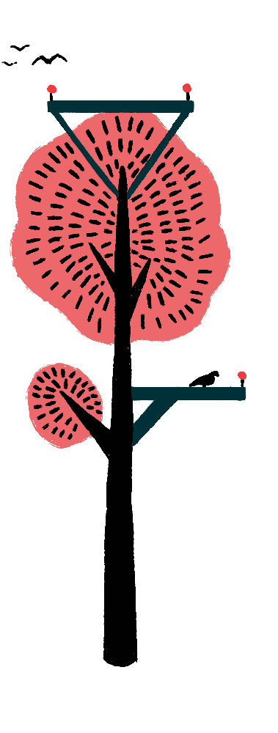
ACT has been nominated for a British Council Legacy Fund to further develop artist led visibility.
Planning for a wider EUROPEAN PROGRAMME FOR 2023 ONWARDS including a MAJOR EVENT IN PARIS IN 2024
WE ARE LOOKING FOR OTHERS WORKING IN THIS SPACE.
IS THIS YOU?
Notes:
whose practice has been disrupted and for whom international mobility is not an option

Slide 25

THANK YOU
Please come and see us in the Culturopolis Marketplace

