Slide 1

People,
Libraries,
Solutions for Europe
Notes:
welcome

Slide 2
We initiate and promote initiatives in culture, civil society and climate to strengthen the European sentiment.

Slide 3
How can we address the challenges Europe is facing today?
People must lead the way
Citizens collective vision, creativity and agency in finding solutions
Reach out beyond the European bubble: places where solidarity can be nurtured
Libraries – safe, relevant, open, democratic spaces
Potential of Libraries as offline social network of Europe
Notes:
2. starting point

Slide 4
The Europe Challenge is an annual learning-by-doing programme that offers funding and support to libraries and communities to explore how we can meet, live together, and work in the Europe of today.
Notes:
2. starting point

Slide 5
Opportunity
to tackle important issues for Europe
to develop great ideas and solutions by citizens
to recognise libraries as vibrant democratic spaces
Notes:
2. starting point

Slide 6




Funding Partners
Notes:
2. starting point

Slide 7
32 libraries and communities from 14 countries and 29 different locations – from the Outer Hebrides in Scotland to Chios in Greece – representing schools, prisons, universities, volunteer libraries and special issue libraries.
They are working on:
Equal rights and inclusion
Active citizenship and participation
Circular economy and environmental wellbeing
Social cohesion
Notes:
2. starting point

Slide 8
Pilot edition (2021-2022) - seven libraries and their communities
Biblioteca Jordi Rubió i Balaguer in Sant Boi de Llobregat, with Apiteca challenge.
theeuropechallenge@culturalfoundation.eu
theeuropechallenge.eu
Notes:
end slide

Slide 9






Slide 10

Project starting point
March 2021 proposal from the Programming and Innovation Unit of the Library Services Management.
The European Culture Foundation to 7 european públic libràries: Valmiera (Latvia), Berlin, Ghent, Kranj (Slovenia), Aarhus (Denmark), Amsterdam and Sant Boi, a grant to enrole participation at The Europe Challenge.
Basis
Goals
Description
Present
Future
Face some of the most urgent European challenges by networking with libraries from all over Europe.

Slide 11
Project starting point
Basis
- Work lines linked to health (PV Salut, CI Discapacitat) and the environment (De l’hort a la biblioteca; BiblioLabs: Ciutat saludable; Llegim el riu)
City Pact (July 2020). AXIS 9 Think city spaces and cultural offer from a new perspective, as assets to contribute the improving of health, emotional well-being, integration and coexistence.
- SDGs
Goals
Description
Present
Future

Slide 12
LINKABLE SDGs
SDG 2
ZERO HUNGER
Safety and nutritional quality improvement.
Sustainable agriculture promotion.
SDG 3
GOOD HEALTH AND WELL-BEING. Ensure healthy living and promote well-being for all people at all ages.
SDG 11
Make cities inclusive, safe, resilient and sustainable
SDG 13
CLIMATE ACTION
AND 15
LIFE ON LAND
Restore and protect terrestrial ecosystems, avoid the loss of biodiversity.
SDG 16
PEACE, JUSTICE AND STRONG INSTITUTIONS Include citizens in the design and implementation of cultural programs, co-creating and co-designing them.
SDG 12
CONSUMPTION AND PRODUCTION
Ensure sustainable consumption and production patterns.

Slide 13
Project starting point
Respond to the Europe Challenge:
  strengthen the position of public libraries as relevant, safe and open spaces in Europe. Become places to solve local challenges involving the knowledge of their communities.
Get a topic that gives stability and continuity to the project:
  Open, that allows the establishment of communities around it.
  Linked with Health and natural environment.
  Framed in the axes of the public libraries new model.
Basis
Goals
Description
Present
Future

Slide 14
Project starting point
Emergency / detected theme:
Bees extinction could affect the agricultural economy and the people’s, animals and environmental health. They are the symbol of climate emergency and for sustainability need.
What do bees symbolize?:
They are the source of inspiration and a learning tool to think on new urbanistic paradigms and environmental frames for the future citizenship.
Which values this project has?
• Wellbeing promotion.
• Environment protection.
• Scientific and technological progress.
• Inclusive values, linguistic and cultural diversity promotion.
Basis
Goals
Description
Present
Future

Slide 15
How does the subject redefine the library relationship with the communities and the overall citizenship?
We are committed to change our approach of services and activities “library created” to a community thought and developed services approach.
Around which subjects could develop new proposals and learning tools?
  Urban beekeeping
  Environmental health
  Climatology
  Sustainable architecture
  Sociology and social cooperation
  Circular economy
  Sensorization
  Gardening
  Arts, literature, history, music, dance, photography,
  ecological engineering
Project starting point
Basis
Goals
Description
Present
Future

Slide 16
Project starting point
- 4 sensorized beehives connected to Beep Platform and one of them 24/7 monitorized.
New and specialized materials for adults and children.
Children area with Apiteca theme.
Collaboration with a nearby high school science group.
Community meeting to define the reach and objectives of the project.
- Suport and collaboration of Municipality Environment Service.
Basis
Goals
Description
Present
Future

Slide 17
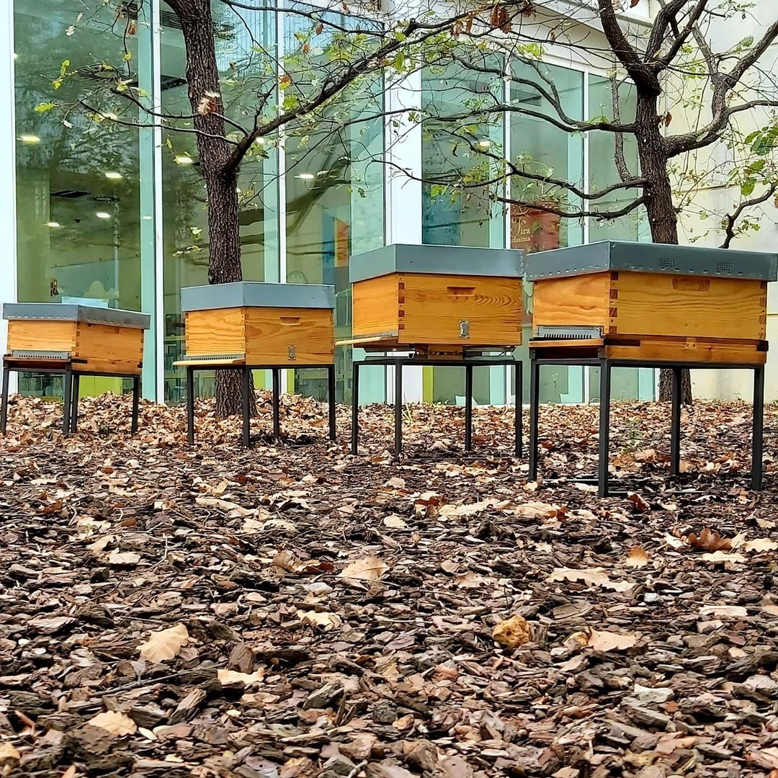

Slide 18
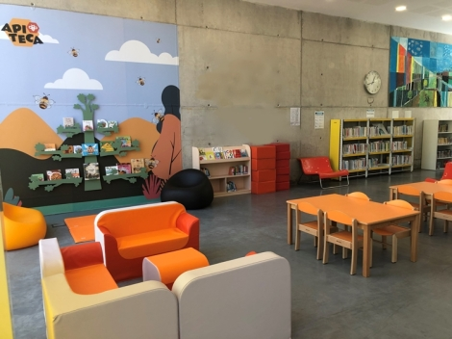

Slide 19
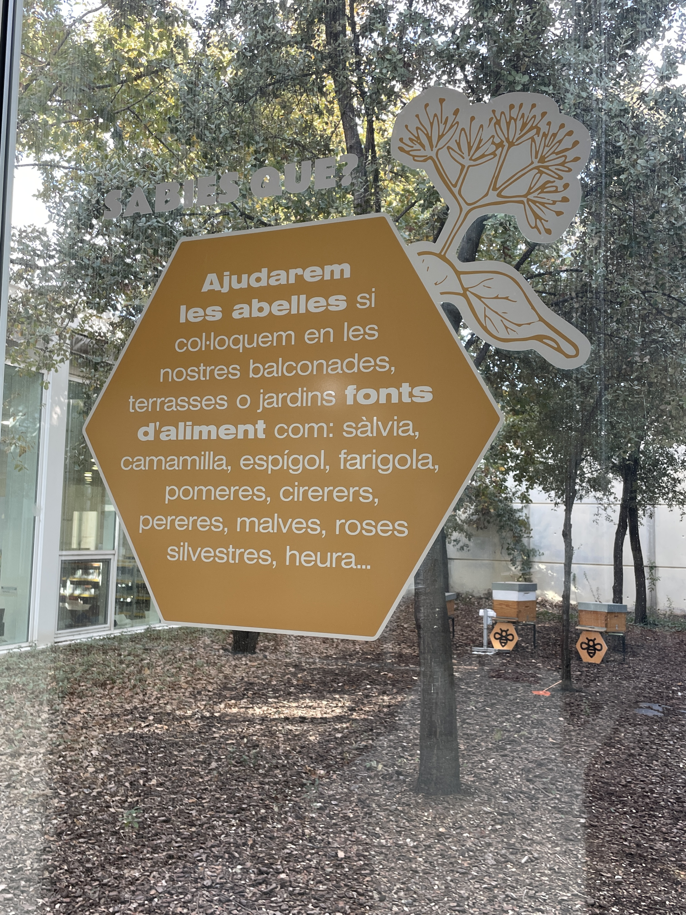
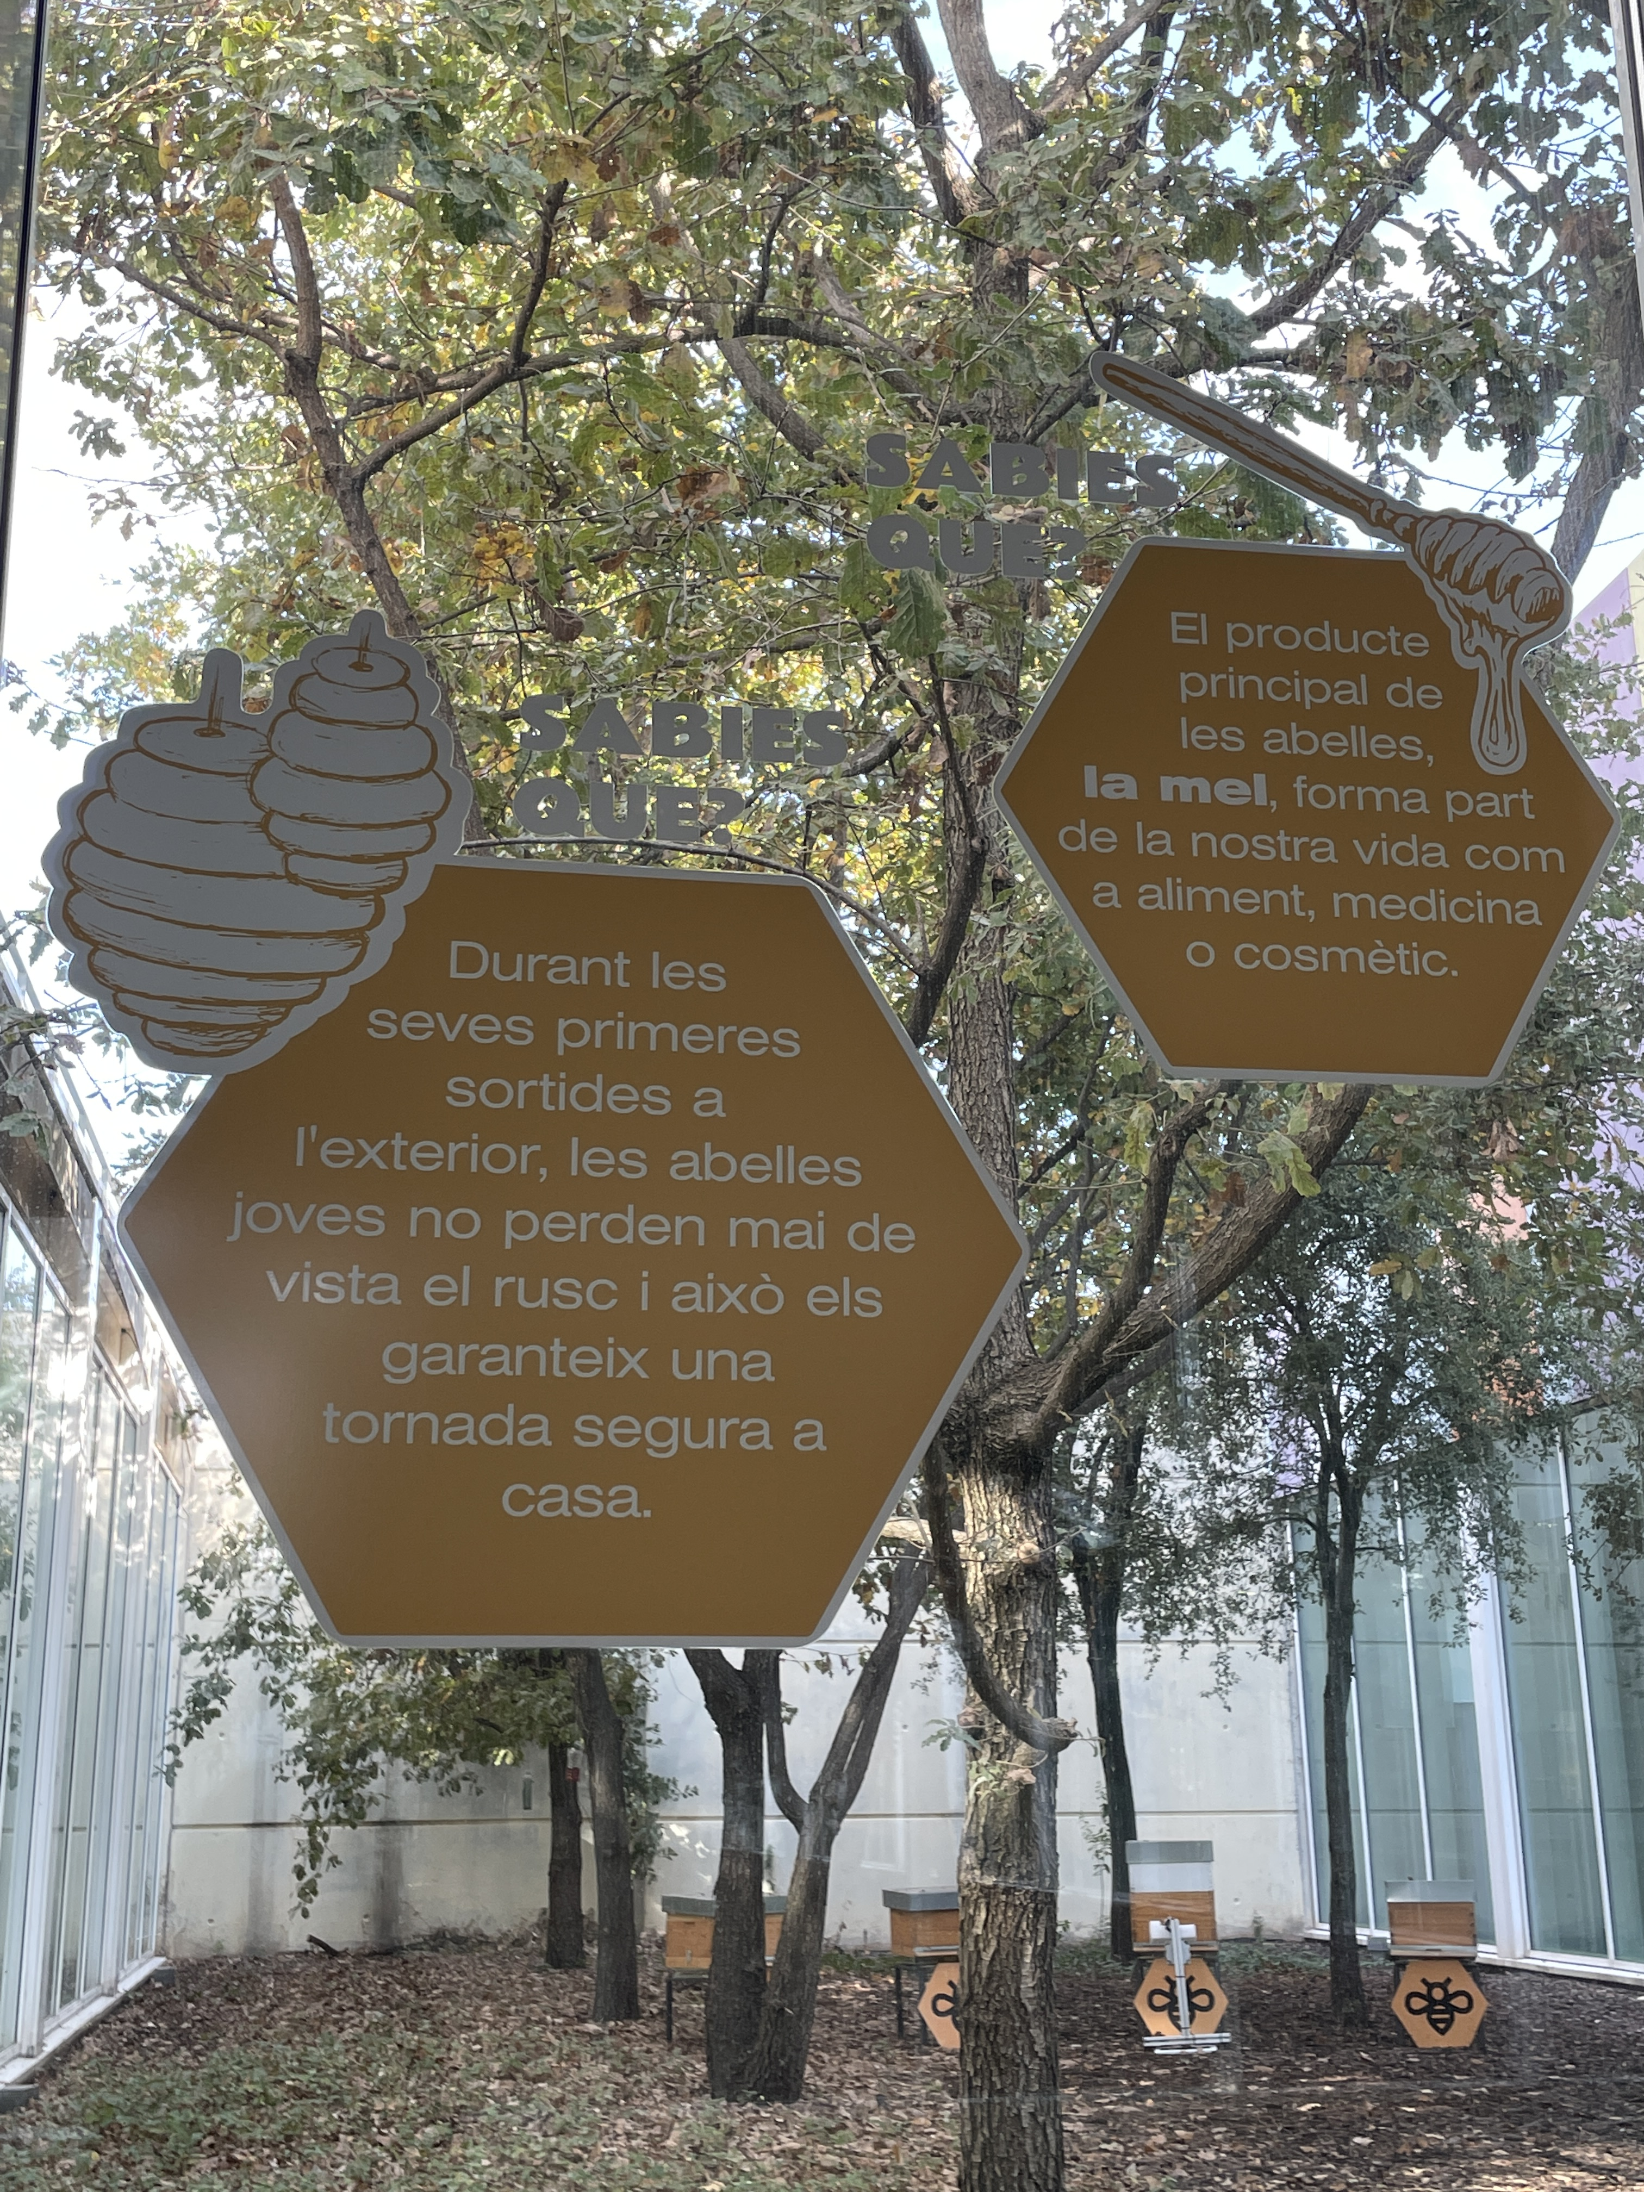
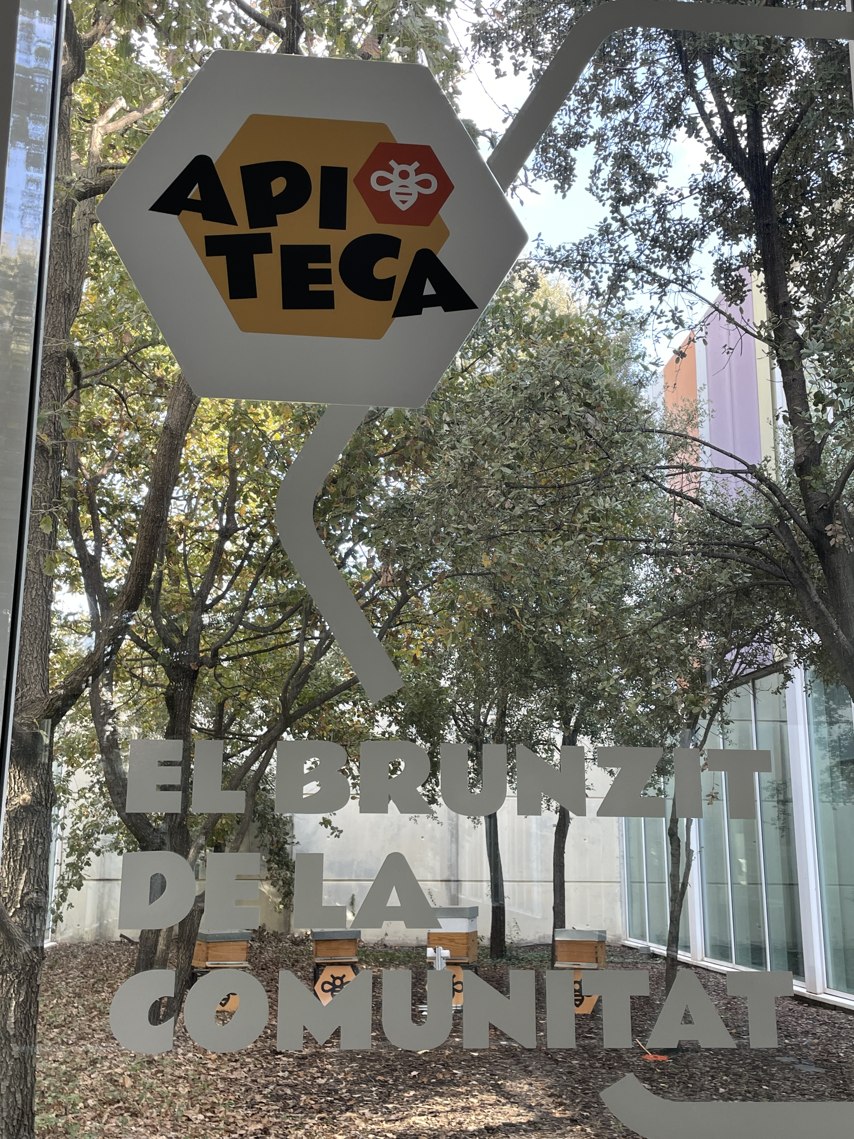
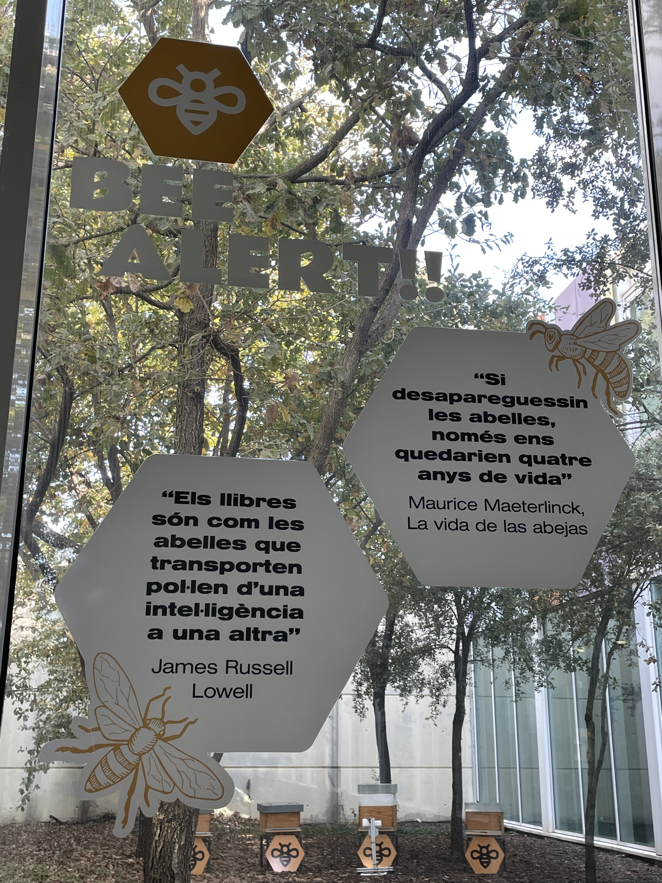
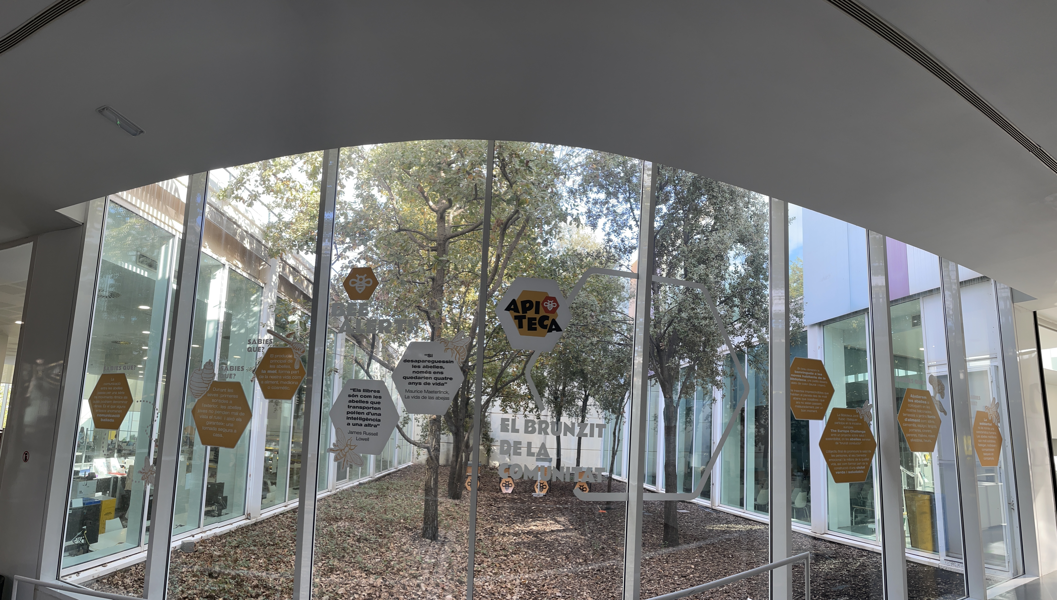

Slide 20
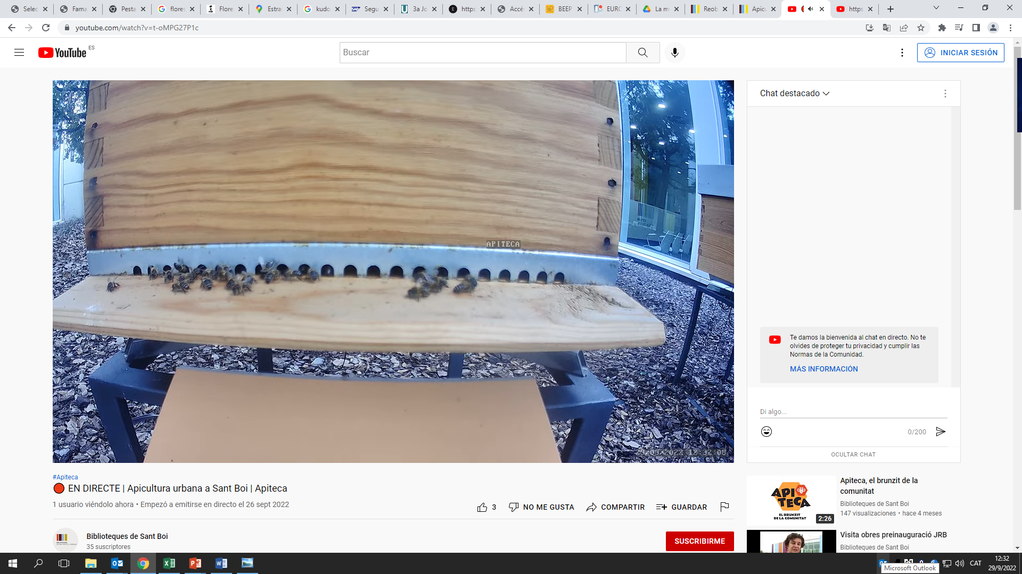
Youtube

Slide 21
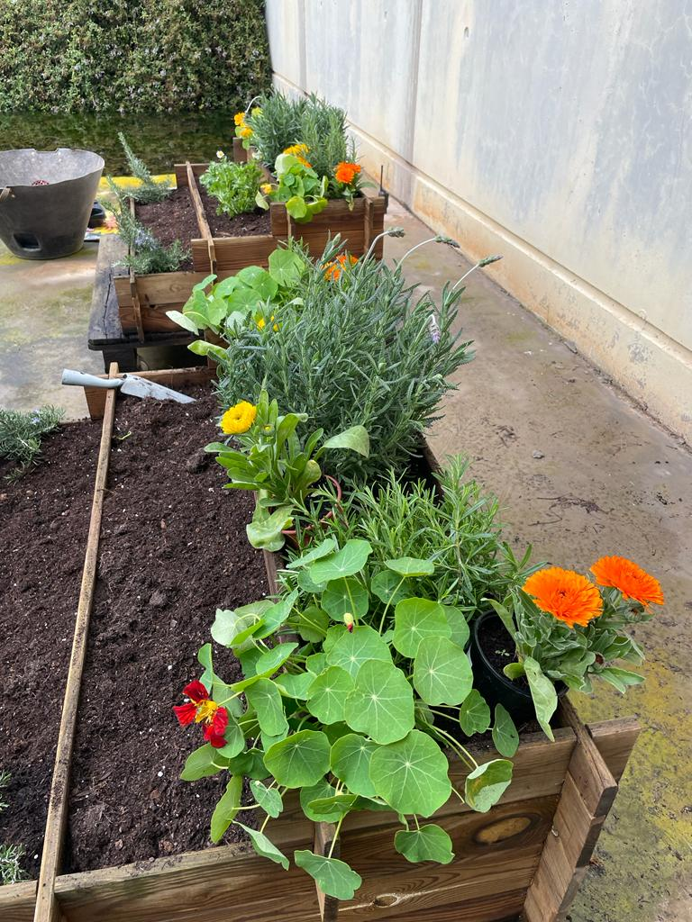
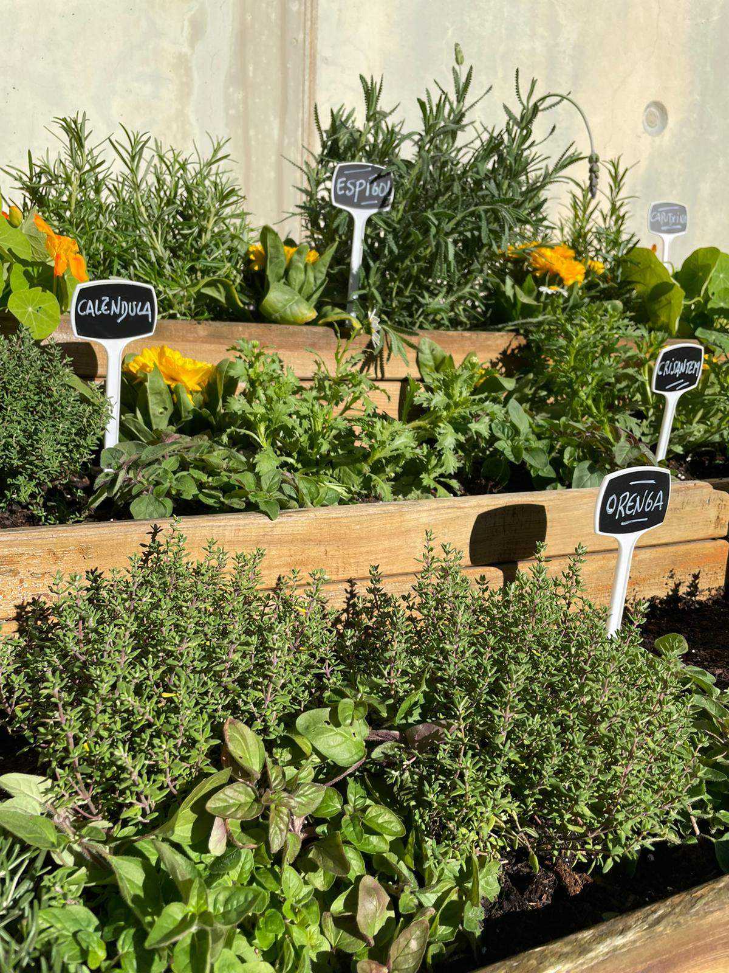

Slide 22
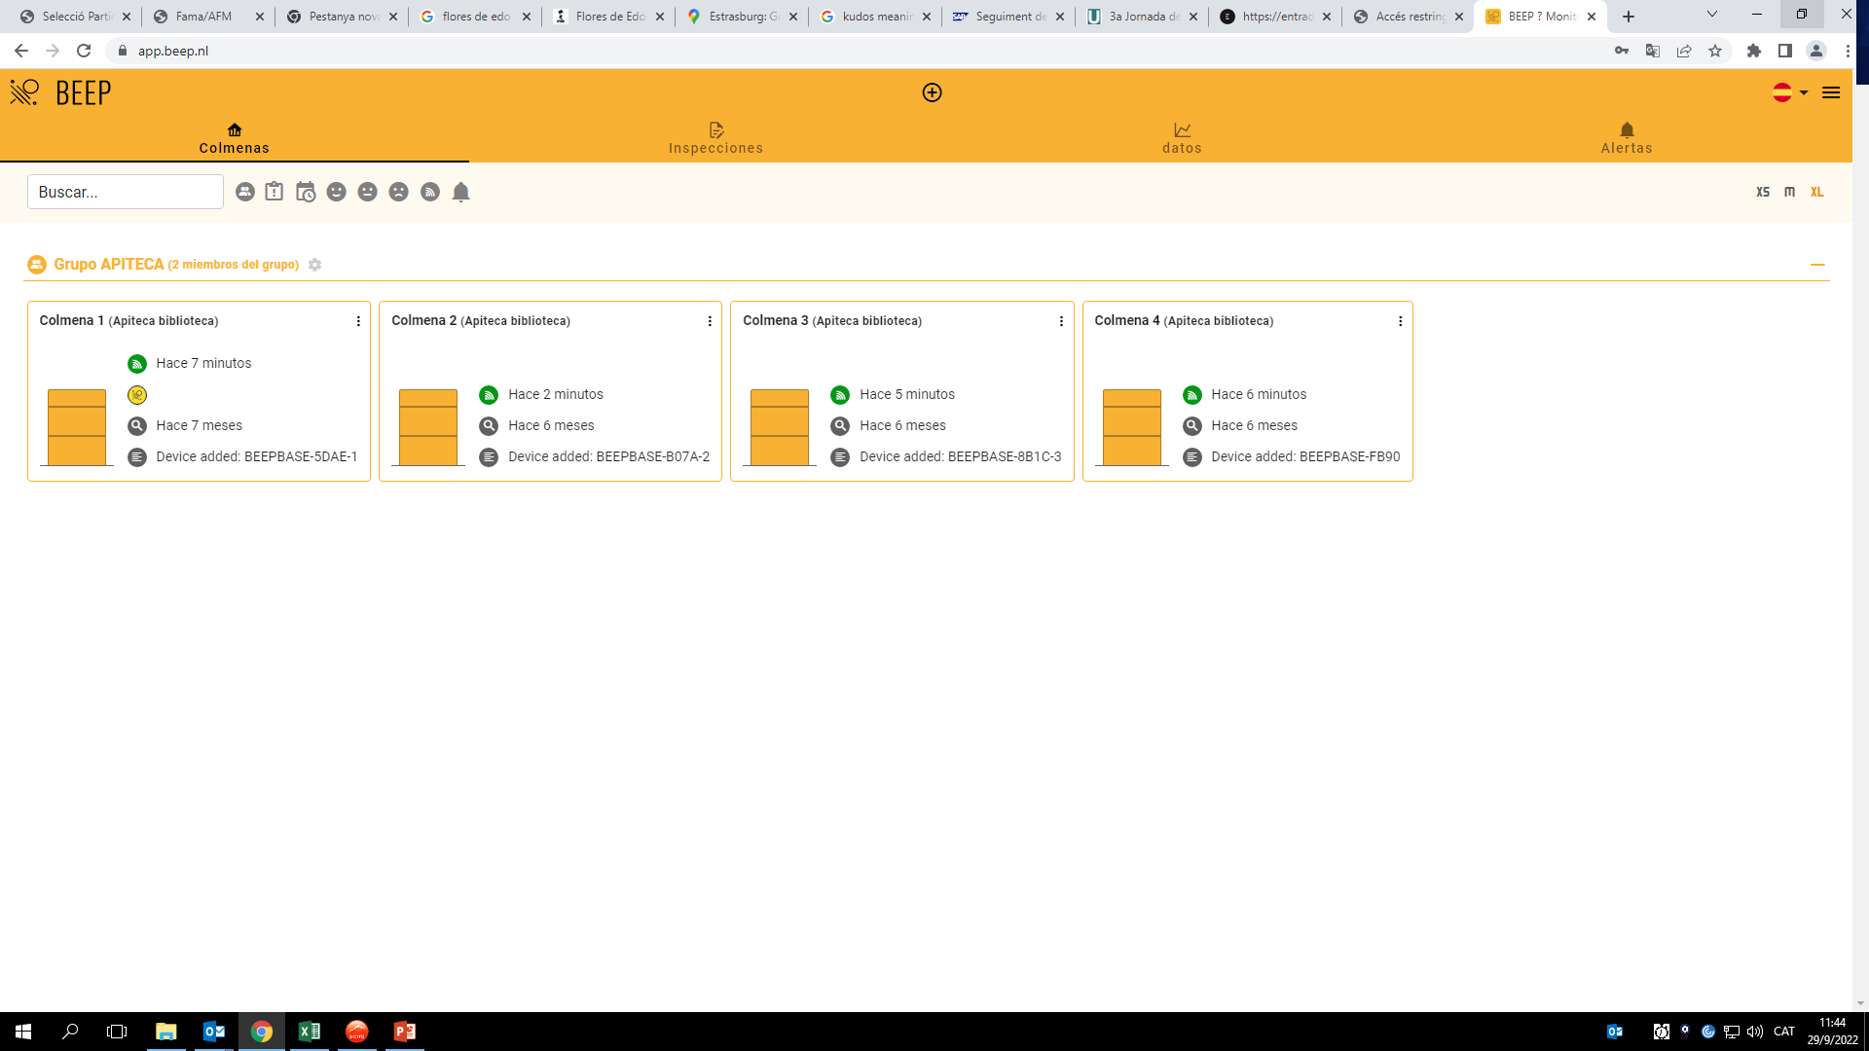
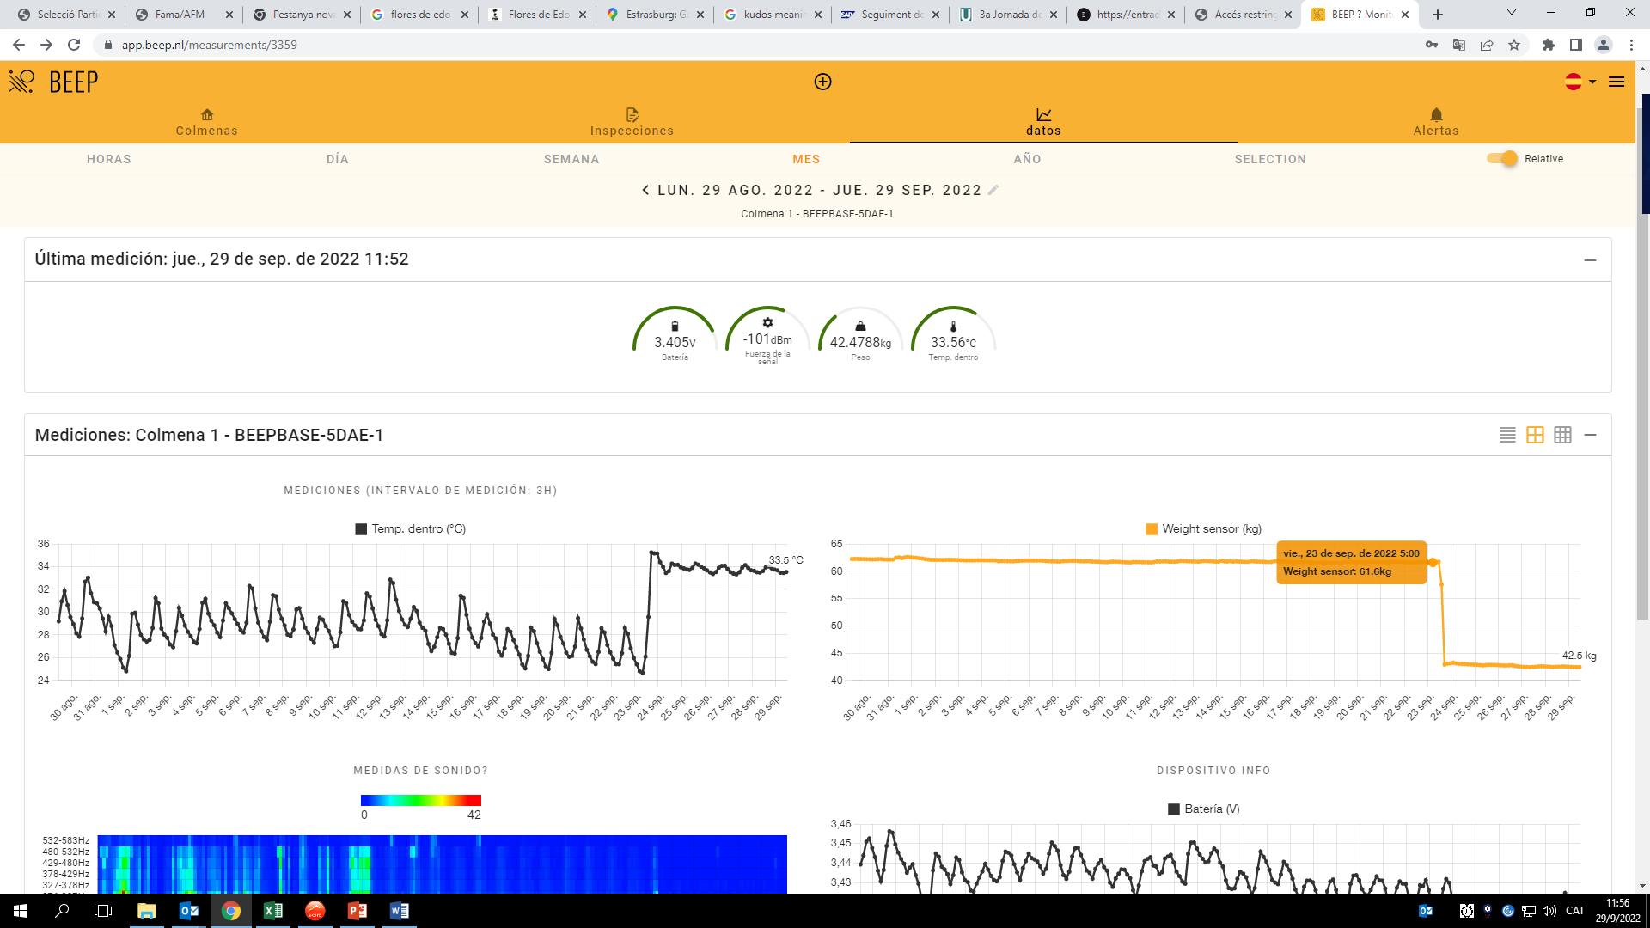

Slide 23
Working together with people in a Shared learning process.
Building an stable group of people interested in beekeeping and in the environment health, with tools for learning and sharing knowledge.
- Connecting with other communities working on similar or complementary projects.
Project starting point
Basis
Goals
Description
Present
Future

Slide 24
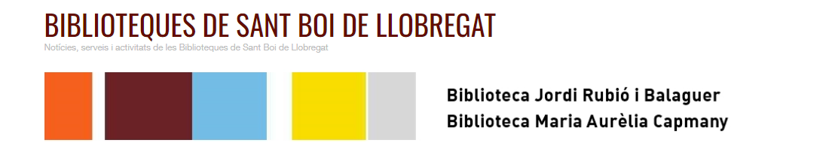
Moltes gràcies!

